Slide 1
Data for Action
Matching common data challenges with practical solutions
Toby Wicks
April 2019
© UNICEF/UN074462/Simon Lister

Slide 2
Multilateral Partnerships
Bill and Melinda Gates Foundation
Shelby Wilson
Senior Program Officer

Slide 3
Data for Action
Matching common data challenges with practical solutions
Emily Garin
April 2019
© UNICEF/UN074462/Simon Lister

Slide 4
Strategic investments by choice, not chance
[ The process: what we did
[ The lessons: what we learned
[ The action: where we are headed

Slide 5
Strategic investments by choice, not chance
[ The process
[ The lessons
[ The action
Notes:
Global strategy
Country action
Cultivating community

Slide 6
Creating a global strategy
Notes:
Global strategy laid out general principles, some strategic directions for HQ and RO, but not enough for country offices to dig into

Slide 7
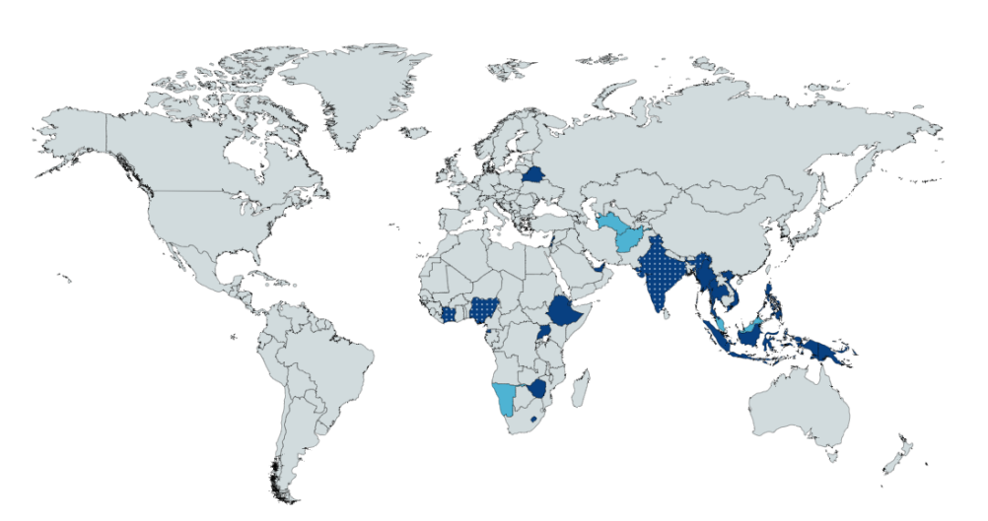
Building country level action plans
Indonesia
Malaysia
Myanmar
Papua New Guinea
Philippines
Thailand
Vietnam
Eq. Guinea
Ghana
Namibia
Nigeria
Afghanistan
Belarus
India
Lebanon
Palestine
Turkmenistan
United Arab Emirates
Completed
Underway
Djibouti
Ethiopia
Lesotho
Uganda
Zimbabwe
Planned
Notes:
Original plan was 6 countries. We’re now at 15 and counting, in part because of leveraging other resources.
This was a combination of both strategic choices (mix of low and middle income, low and high capacity, humanitarian/non-humanitarian) and opportunism based on interest.
Coming soon: ESAR interest across the region, WCAR testing, will experiment with workshops to build capacity in several smaller countries at once (eastern Europe, latin America)

Slide 8
Building country level action plans
Step 1: Identify the areas of work where a shift in data investments is most likely to change results for children
Step 2: Map the data landscape in those areas of work
Step 3: Build the strategic action plan
Implementation and learning
Notes:
Two background points to the logic behind this approach:
Needs to be actionable (not high level strategy but actionable plan)
Move away from a tools-first approach

Slide 9
Building country level action plans
Report Section | Recommendation
Priority UNICEF interventions
Governance of indicator frameworks | Play a catalytic role, in conjunction with all concerned stakeholders, in developing a globally consistent set of indicators for use by C4D programmes and surveys.
Governance of information systems | In conjunction with other development partners provide both technical and financial support to NITA and MDAs (notably MOH, MOGLSD and JLOS) engaged in strategies or initiatives to integrate systems or enhance the interoperability of systems.
Data for local decision making | Conduct a feasibility study for a major investment in the Community Information System to assist the NSO and MOLG to expand the programme to all districts and to support the coordination and capacity building of local level data collectors from different sectors
Data Use | Establish a facility to provide the NSO and MDAs with financial and technical support to make all official statistics open by default and support initiatives – from government, academia and civil society - that encourage the use and analysis of data to inform decision-making.
CRVS and National Identity | In conjunction with the World Bank extend UNICEF’s existing commitments to NIRA and the CRVS system in general to streamlining the bureaucratic and technical links between birth registration and national identity.
Health | Continue to invest in the HMIS with an emphasis on the rationalisation of indicators and improvement of data quality. Similarly invest in the speediest possible development of the Electronic Health Record and its integration with the HMIS.
Water and Environment | Support NITA and MOWE to rationalise WASH information systems and to streamline the processes between data collection and database entry and use.
Education | Work with development partners, MOES, NITA and the NSO to champion the need for a sustainable EMIS that delivers timely, usable data at all levels from school to ministry.
JLOS and Social Development | In conjunction with other development partners, provide both technical and financial support to NITA, MOGLSD and JLOS to integrate and/or enhance the interoperability of their systems. (This is a repeat of the general recommendation presented under Governance of information systems above)
Data for local decision making | Conduct a feasibility study for a major investment in the Community Information System to assist the NSO and MOLG to expand the programme to all districts and to support the coordination and capacity building of local level data collectors from different sectors
Data Use | Establish a facility to provide the NSO and MDAs with financial and technical support to make all official statistics open by default and support initiatives – from government, academia and civil society – that encourage the use and analysis of data to inform decision-making.
Notes:
Structures vary – some are stop, start, do more, do less
- Others are about interventions, policies, etc.

Slide 10
Strategic investments by choice, not chance
[ The process
[ The lessons
[ The action

Slide 11
Three themes for global investments
Strengthening internal data capacity
[ Building data savvy within UNICEF offices
[ Improving data communication and advocacy skills
[ Addressing data gaps on key marginalized populations
Addressing gaps and emerging issues
[ Making data systems work better together
[ Providing clear, actionable guidance on data privacy, protection, and ethics
[ Addressing administrative data quality issues
[ Understanding the unique data challenges of humanitarian contexts
Working better with governments
[ Creating a culture of use
[ Advocacy to address sensitive topics with governments
[ Strengthening UNICEF capacity to strengthen government capacity
Notes:
(full webinar coming in 2 weeks)

Slide 12
Strategic investments by choice, not chance
[ The process
[ The lessons
[ The action
Notes:
The goal of all our work is to provide solutions AT SCALE – not bespoke, but replicable

Slide 13
Strengthening internal data capacity
[ Building data savvy within UNICEF offices
[ Improving data communication and advocacy skills
[ Addressing data gaps on key marginalized populations

Slide 14
Addressing gaps and emerging issues
[ Providing clear, actionable guidance on data privacy, protection, and ethics
[ Addressing administrative data quality issues
[ Understanding the unique data challenges of humanitarian contexts

Slide 15
Working better with governments

Slide 16
Collaborating on tough issues
[ Making data systems work better together
[ Creating a culture of use
[ Advocacy to address sensitive topics with governments
[ Strengthening UN capacity to strengthen government capacity

Slide 17
Leveraging new resources for results
[ Launching the Data for Children Trust

Slide 18
Data for Action
Toby. twicks@unicef.org Coordination, partnerships and innovation | Emily. egarin@unicef.org Country and regional office support | Han. hhan@unicef.org Knowledge, learning, and communities
Karen. kcarter@unicef.org Administrative data | Kate. ktalley@unicef.org Humanitarian data | Mac. mglovinsky@unicef.org Solutions

Slide 19
Do you agree?
What is missing?
How can we move forward together?

