Slide 1
Ethical principles, dilemmas and risks in collecting data on violence against children
Findings from the work of the CP MERG technical working group on
violence against children
Claudia Cappa,
Statistics and Monitoring Section
UNICEF HQ

Slide 2
Objective and content
Present results of an in-depth literature review on ethics in data collection on VAC commissioned in 2012 by the Technical Working Group (TWG) on Violence against Children (VAC) of the global Child Protection Monitoring and Evaluation Reference Group (CP MERG)
Discuss current thinking regarding ethical issues and existing empirical support for ethical research practice and decision-making in collecting data on violence against children
Highlight specific ethical dilemmas and the existing debates and recommendations regarding these within the literature from ethical guidelines and codes to research publications

Slide 3
CP MERG Technical Working Group on Violence against Children

Slide 4
Background
Part of the CP MERG
Established in April 2011
8 members: ILO, Save the Children, Pop Council, ChildFund, Plan International, EU FRA, ICF MACRO, UNICEF
Chaired by UNICEF
More information available at: http://www.cpmerg.com/

Slide 5
Rationale
Proliferation of different measurement efforts aimed at filling the existing gaps, primarily using large-scale population-based surveys
Absence of commonly agreed operational definitions of VAC and standardized data collection tools
Different standards and practices for protection of respondents and interviewers, and follow-up support to victims
Absence of ethical guidelines on data collection on VAC

Slide 6
Goal and objectives
Goal: assist countries/partners in their efforts to gather reliable, useful, comparable and ethically sensitive data on VAC
Objectives: Development of guidelines for the collection of data on VAC
Technical guidelines aimed at maximizing the disclosure of actual violence and at guaranteeing high quality data
Ethical guidelines aimed at minimizing the risk of potential harm to respondents, interviewers and others, resulting from the data gathering process

Slide 7
2012 outputs
Conducted a literature review on research ethics and risks associated with data collection on violence against children
Conducted a mapping exercise and a critical assessment of data collection efforts to identify existing self-report survey tools and methods that are being used or are under development in the area of violence against children
Two publications, to be released in Oct/Nov 2012

Slide 8
Next steps
Development of guidelines for data collection on violence against children
Intended for use by NSOs and other agencies that want to gather data on VAC
Training material and workshops on the guidelines

Slide 9
Literature review on ethics and risks

Slide 10
Content
Documentation, including both published and ‘grey’ literature, that is of specific relevance to research ethics in collecting data on VAC
Review of ethical principles and frameworks
Review of ethics documentation: guidelines, codes and standards
Review of published literature on ethical challenges and dilemmas
Review of published literature on risks associated with collecting data on VAC

Slide 11
Ethics in research
First acknowledged formally with the development of the Nuremberg code (1947); based on Anglo-American law, focused on respect for personal integrity in experimental research
Subsequent ethical guidelines and codes were developed for medical research, aimed primarily at biomedical clinical studies
First international code of ethics was the Declaration of Helsinki which was written for medical research

Slide 12
Main frameworks
Duties
Most widely established framework underpinning guidelines and codes
Right actions treat people as ends, not means
Universal duties
Principles of autonomy, beneficence-maleficence, justice
Best outcomes
Strategies to reduce harm and costs, and promote benefits
Rightness or wrongness depends on the nature of the consequences
Rights
Recognition and promotion of children rights as expressed in the CRC (best interest, non-discrimination and right to be heard)
Virtues
Base on people’s possessing and acting on good characteristics rather than vices
Lack of culture agreement on what constitutes virtues and vices

Slide 13
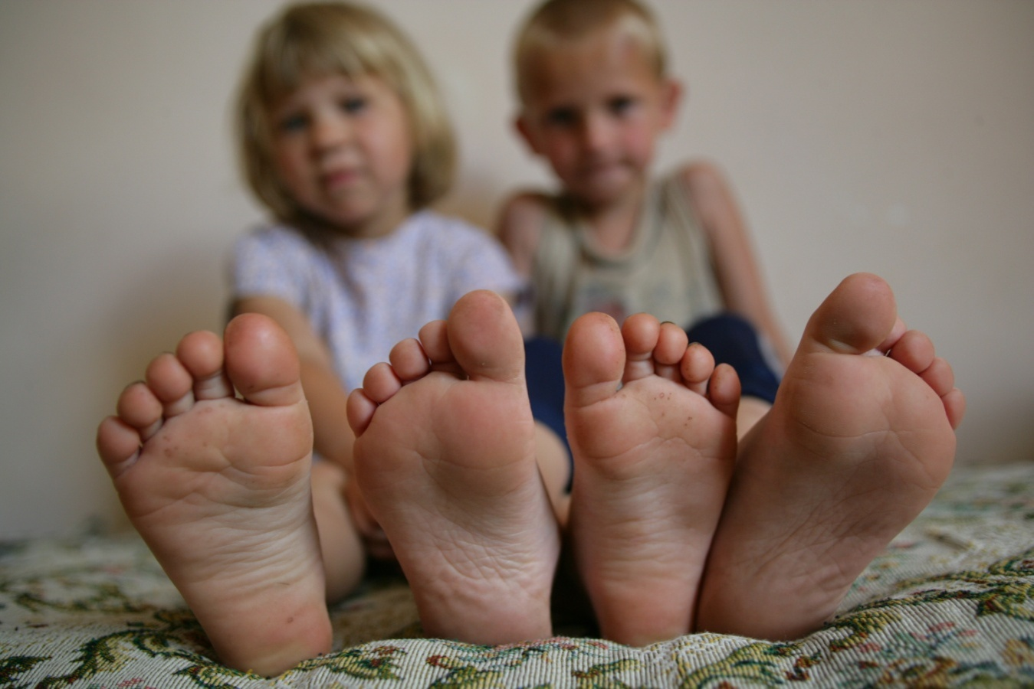
Ethical challenges, dilemmas and risks

Slide 14
1) Impacts on children of participation in research on VAC
Does involvement in child abuse research conflict with ethical principles of beneficence and non-maleficence?
Is it justifiable to include children in abuse research classified as non-therapeutic that has limited, indirect or minor benefits for children?
What are the possible long-term consequences?

Slide 15
The benefit of research
Review found limited literature to support the argument that there are positive benefits for children who participate in research on VAC
Available studies on children did not focus specifically on trauma related to violence, but on injuries
From available (literature not related to violence): One benefit of participation may include a positive feeling, even when the topic is serious or the child has had traumatic experiences

Slide 16
Risk of discomfort, distress or trauma
Children who have experienced violence: concern is whether involvement in research will cause them discomfort, distress or even re-traumatization, perhaps in the form of memories or flashbacks
Children with no known history of experiencing violence: concern is the potential harm of exposing them unnecessarily to distressing issues that are alien to them

Slide 17
Some findings
Minimal research has been done on the effect of questions about violence
Recent US national survey on VAC (1,588 participants aged 10-15 years, Ybarra et al., 2009)
Around one quarter (23 per cent) reported being upset by questions, with younger participants far more likely to be upset than older participants.
Children who had experienced victimization were just as likely as those who had not been victimized to not be upset by the violence-related questions.
Another US study found (Langinrichensen-Rohling et al., 2006)
30 per cent reported some level of being upset The highest rates were found among younger, middle school children and a truancy sample within a juvenile justice setting. Young people in this study who reported a history of physical or sexual abuse (or suicidal thoughts or drug use) reported feeling upset more often than those without such experiences.

Slide 18
Recommendations
Call for further research on the potential risks and benefits to children and young people from participating in research on VAC
In the absence of such empirical evidence, the relatively high number of children reporting upset (between one-quarter and one-third of participants in some studies cited above) suggests the need for caution and for the careful selection of methodologies to ameliorate distress
These could include a debriefing with children; telling children where and how they can get help; the use of computer assisted self- interviewing methods; and a child-centred approach
Some of these suggestions less appropriate to resource-poor countries and in large-scale data collection efforts

Slide 19
2) Challenges related to the provision of information
How much information to provide to children and how much to provide to parents and communities?
What are the possible impacts of disclosing information on survey participation and possible risks?

Slide 20
Some principles & findings
Principle of parents acting in the best interest of the child cannot be assumed in research on VAC
Actual consequences on children of disclosure remains unknown and difficult/unethical to investigate
Reviews of different (more or less explicit) consent forms for parents in the US show no impact on participations rates (Runyan, 2000)

Slide 21
Recommendations
Further research is needed. This includes research on how parents weigh up the risks and benefits of participation
Different provisions are appropriate in different contexts
Need for researchers to be reflexive in their practice and attentive to the rights and responses of children and young people, and attuned to their expression

Slide 22
3) Children’s consent to participate in research
Extent to which children understand the nature of the research and the implications of their consent
Principle that consent can only be given if the participant has been fully informed is recognized in principle, but found problematic in practice
Children are likely to interpret information in the light of understandings they already have (David et al., 2001)
“Mismatches of understanding can be difficult if not impossible to detect” (Gallagher et al., 2010, p. 478)

Slide 23
Some findings
Study by Abramovitch and colleagues (1991): many children thought that there would be negative consequences if they did not comply, and felt under pressure to agree to participate if their parents had given consent.
A US study with children aged 8-12 found that children understood their research rights, but were unconvinced about confidentiality (Hurley and Underwood, 2002).
Kalter and colleagues (1988) : young children often misunderstand confidentiality to mean that they must keep secret from their parents what they say to the interviewer.
Participants in one health study thought the researcher would be unhappy if they withdrew from the study (Ondrusek et al., 1998).

Slide 24
Recommendations
Researchers should endeavour to ensure that children and young people fully understand what is involved in their participation
Encourage questions and clarification, and allowing sufficient time for potential participants to reflect on and decide about taking part
Strategies can be employed to by researchers to assess children’s understanding of consent/assent, for example, using quizzes, asking children questions one-to-one or asking them to summarize what they have been told
Not always possible and require close controls over interviewers

Slide 25
4) Confidentiality in relation to child protection
Whether child abuse should be asked about in research at all
Whether child abuse should be asked about in research in countries where there are no services
Whether reporting suspected child abuse is mandated by the principle of beneficence
Whether researchers should be legally mandated to report suspected child abuse

Slide 26
Some findings
General consensus of the need for research even in contexts where resources are not available for follow-up
Many arguments in both favour and against all the other dilemmas found in the literature
Large and controversial debate mainly in USA and UK, Canada
Less debate in LAMI countries
Very different practices

Slide 27
Concluding considerations
Existing gaps in documentation and research, and areas of potential risk to children
With such gaps in the research it is difficult, at present, to derive any full understanding of these issues
Further research in these areas is critical, especially as research and data collection continues despite the lack of an evidence base, raising the pivotal question of whether this research is in the best interests of the children participating
Need to develop a strong children’s rights-based framework for ethical research practice, which provides clear direction while supporting reflexivity

Slide 28
Thank you
ccappa@unicef.org

