Slide 1
OOSCI
Out of School Children Initiative
Notes:
1
1

Slide 2
What is the Out of School Children Initiative?
OOSCI was launched in 2010 by UNICEF and UIS
Who are the children out of school and where are they?
Why are these children out of school?
How can they be brought to school and stay there?
Notes:
2
OOSCI is designed to translate data into action.
Starts by finding out who and where OOSC are.
Next, works out why they are out of school.
Finally, proposes actions that will get them into school.

Slide 3
Why do we want ALL children in school?
Education is a human right. It empowers people to survive and thrive and is our most effective weapon against poverty
Education is associated with more peaceful communities, greater civic engagement and stronger democracies
Half of the recent reduction in maternal and infant mortality is due to more education for girls
Education is one of the best economic investments available with returns of $10 - $15 on the dollar
Each addition year of schooling is associated with an increase of 0.37% in GDP, rising to 1.0% with improved learning outcomes
As many as 250 million children of primary school age are failing to learn the basics
Notes:
3
3
Intend to ask audience for reasons why children enter late and drop out early.

Slide 4
What does OOSCI do?
OOSCI aims to make a substantial and sustainable reduction in the number of children out of school
Notes:
4
4
Once stall was recognised, UNICEF and UIS launched OOSCI.

Slide 5
How much progress has been made?
30+ Country Studies completed
20+ Country Studies in the pipeline
7 Regional Reports published
Global Report launched on 19 January 2015
Notes:
5
5
Once stall was recognised, UNICEF and UIS launched OOSCI.

Slide 6
Out-of-school children: What data (visually) tells
Hiro Hattori
Data & Analytics Section
UNICEF, New York

Slide 7
If the world were a village of 100 children of primary school age…

Slide 8
9% of children out of school
II
58 million

Slide 9
If the world were a village of 100 adolescents of lower secondary school age…

Slide 10
17% of adolescents out of school
II
63 million

Slide 11
Reasons for out-of-school vary among regions.
Notes:
11

Slide 12
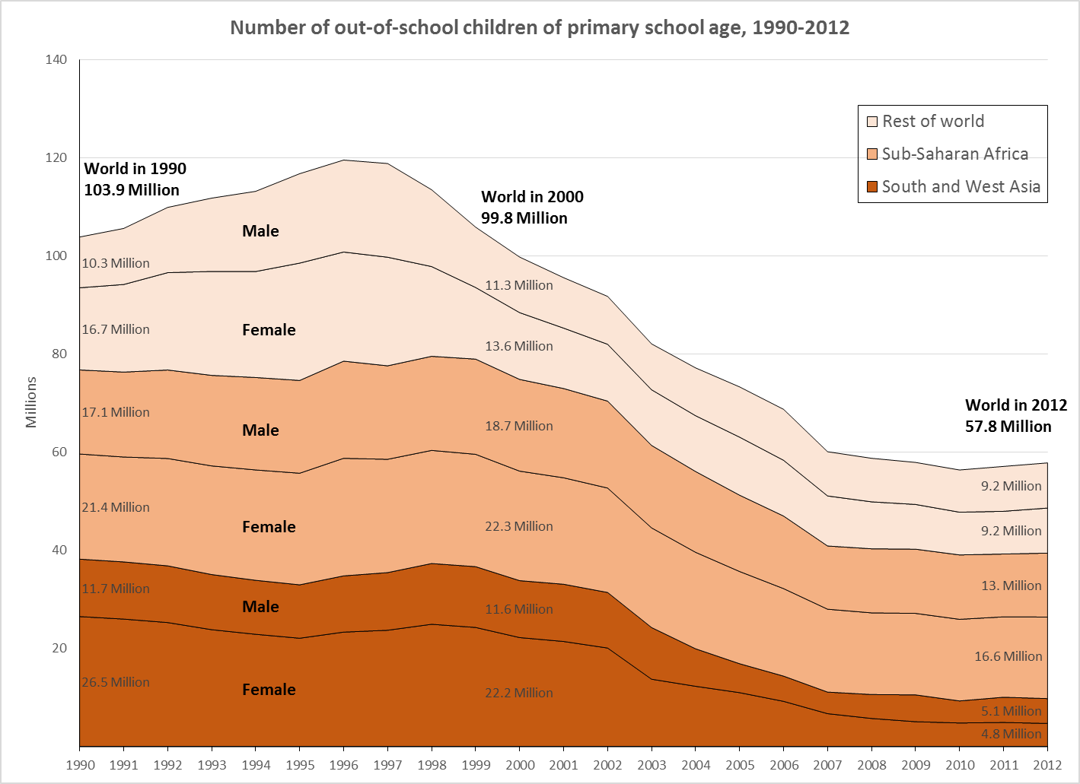
The global trend of OOSC
Notes:
12

Slide 13
The global trend of OOSC
Need another 200 years!
2013
2014
2015
2016
2017
2018
Notes:
13

Slide 14
Notes:
14

Slide 15
Stagnation of education MDG alarming!
Notes:
15

Slide 16
SSA and SA are main drivers of stagnation.
Notes:
16

Slide 17
Why has the progress stalled in recent years?

Slide 18
GDP growth (annual %), 2000-2013
Economic growth has slowed down since 2008.

Slide 19
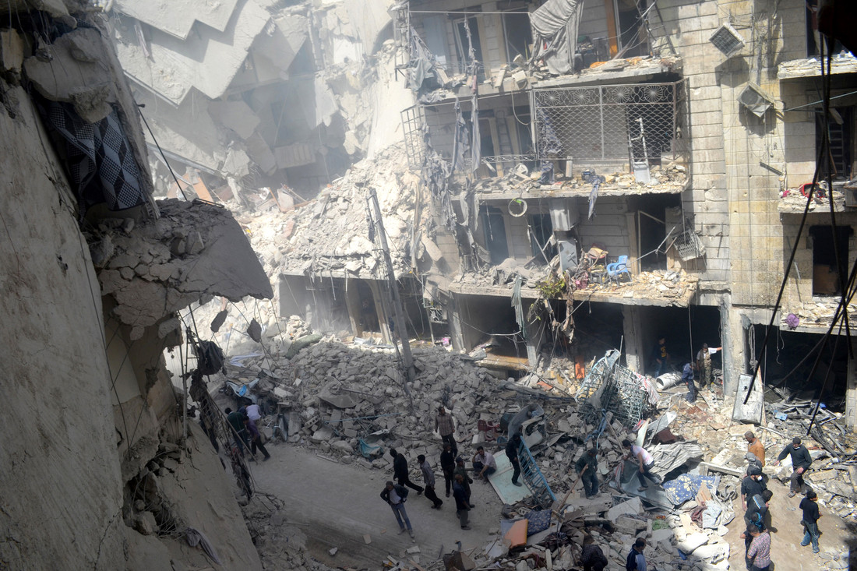
Increased cases of emergencies and humanitarian crisis.

Slide 20
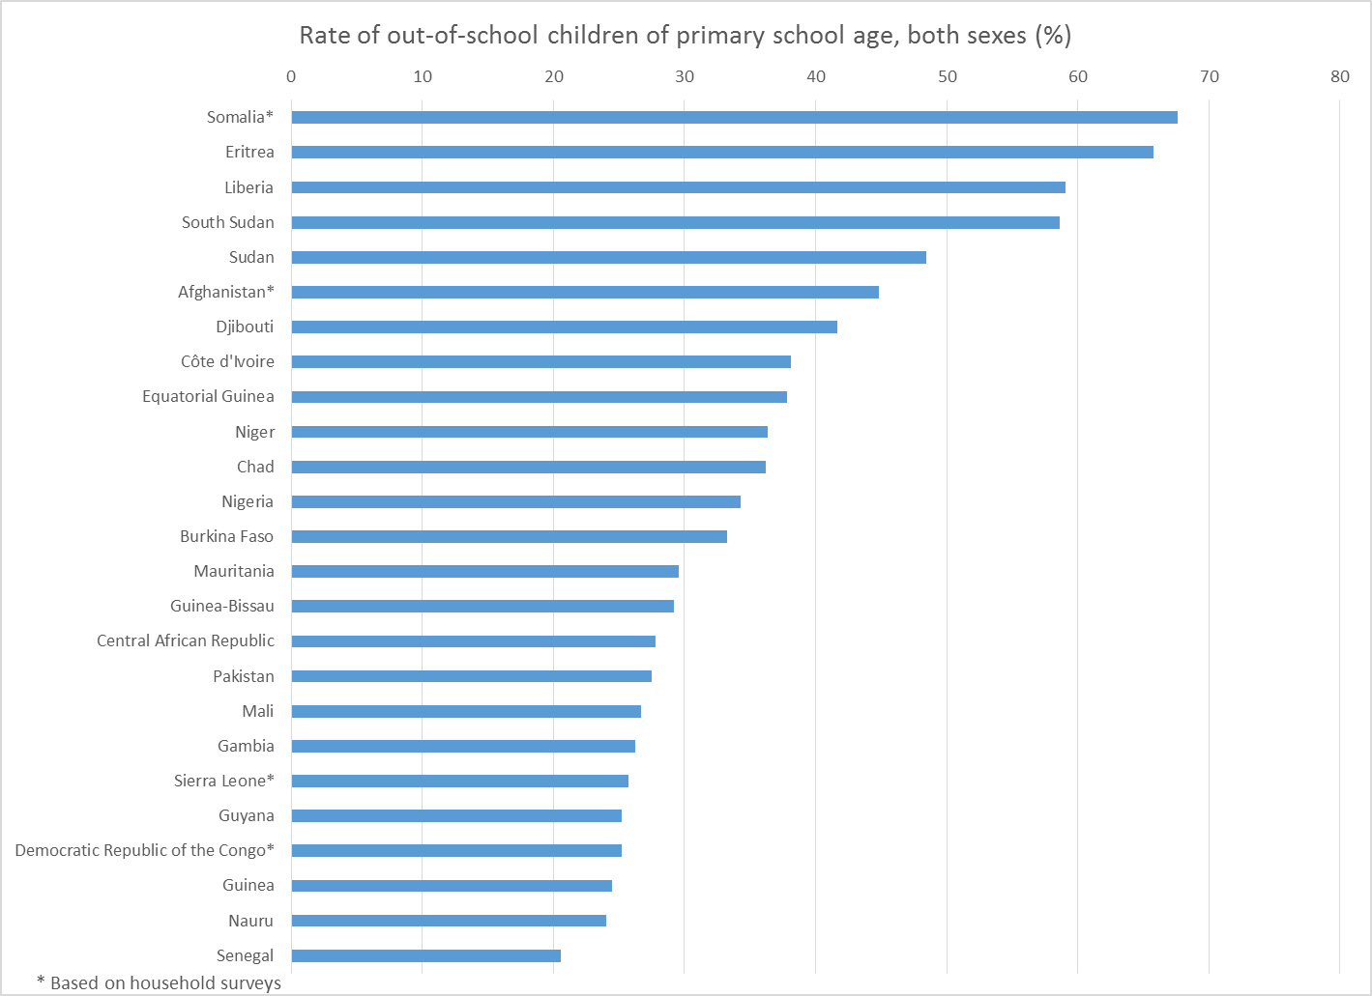
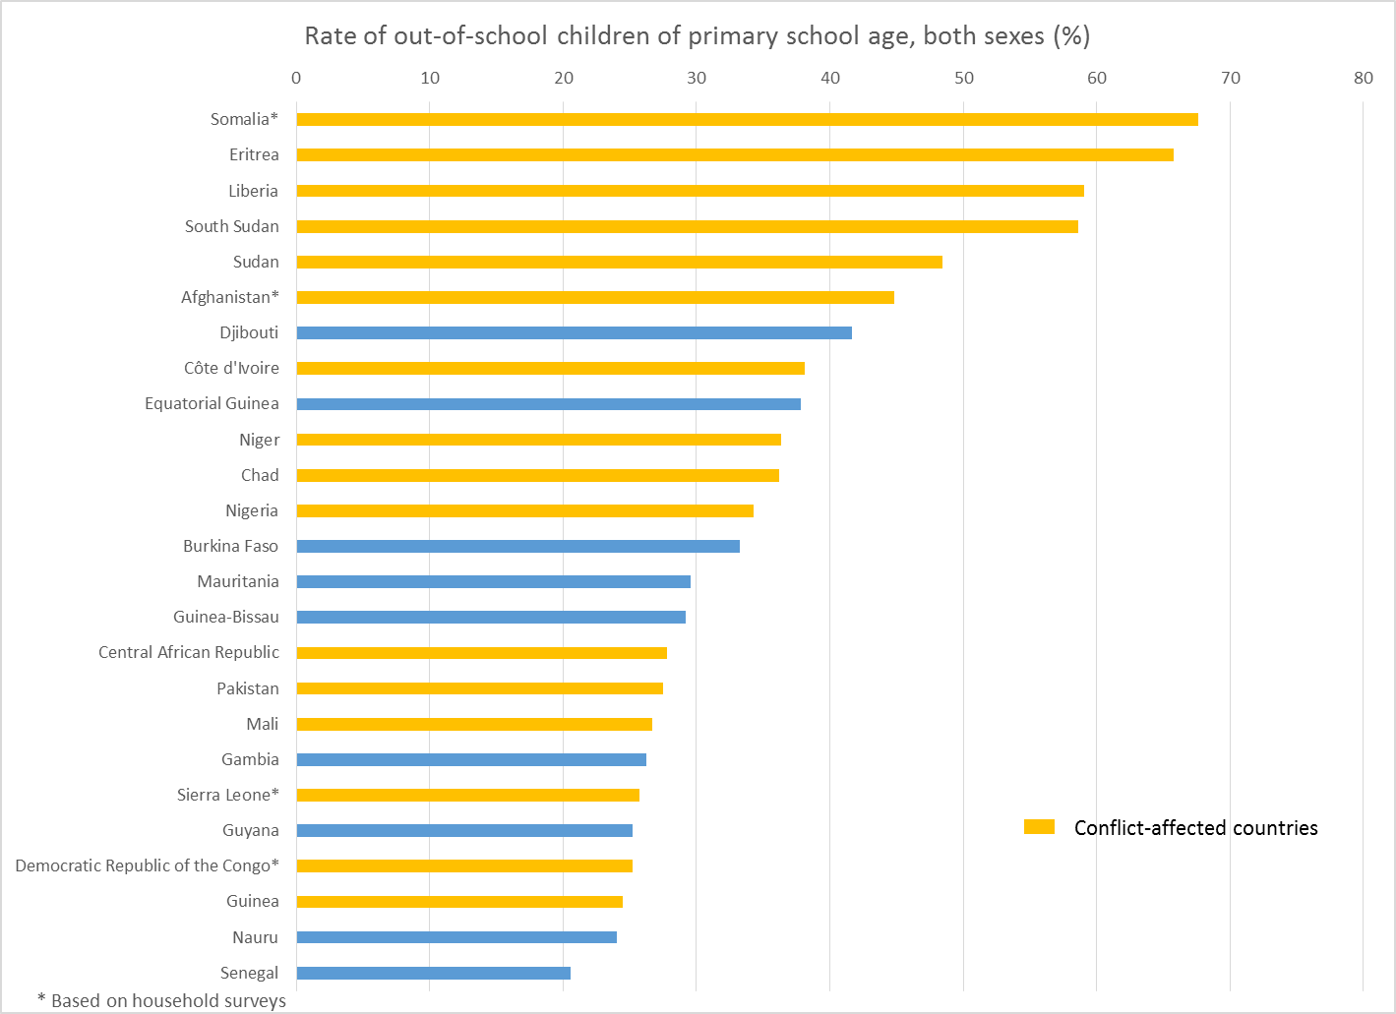
Majority of countries with high OOS rate are conflict-affected.

Slide 21
Existing data do not support conflict hypothesis.

Slide 22
Performance of big countries affect global trends.
Notes:
These 10 countries reduced OOSC number by 3.4 million. However these 7 countries increase OOSC numbers by 4.2 million.

Slide 23
Rapid population growth in sub-Saharan Africa
Notes:
Southern Asia – only 2% increase.

Slide 24
Faster growth in school enrolment needed.

Slide 25
School enrolment has stagnated since 2007.

Slide 26
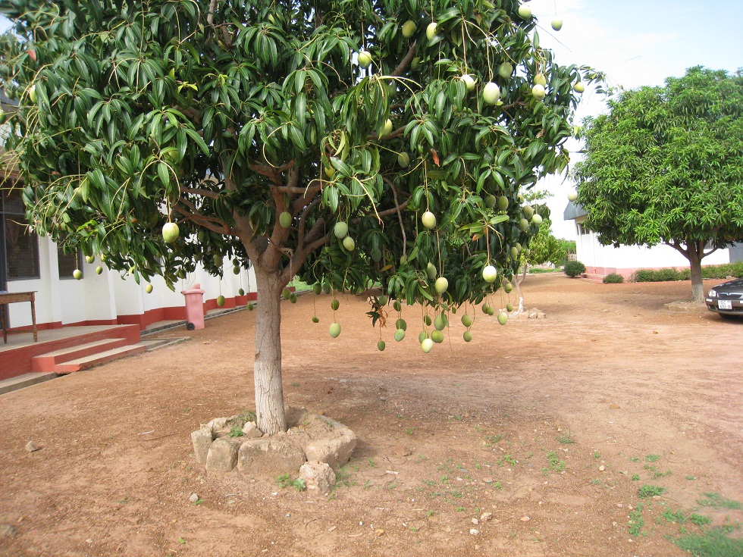
How to reach
them?
Low-hanging
fruits!
“Business as usual” wouldn’t work to reach the hardest to reach.

Slide 27
“Build it, they will come” optimism won’t work any more.

Slide 28
Where are the world’s 58 million out of school children?

Slide 29
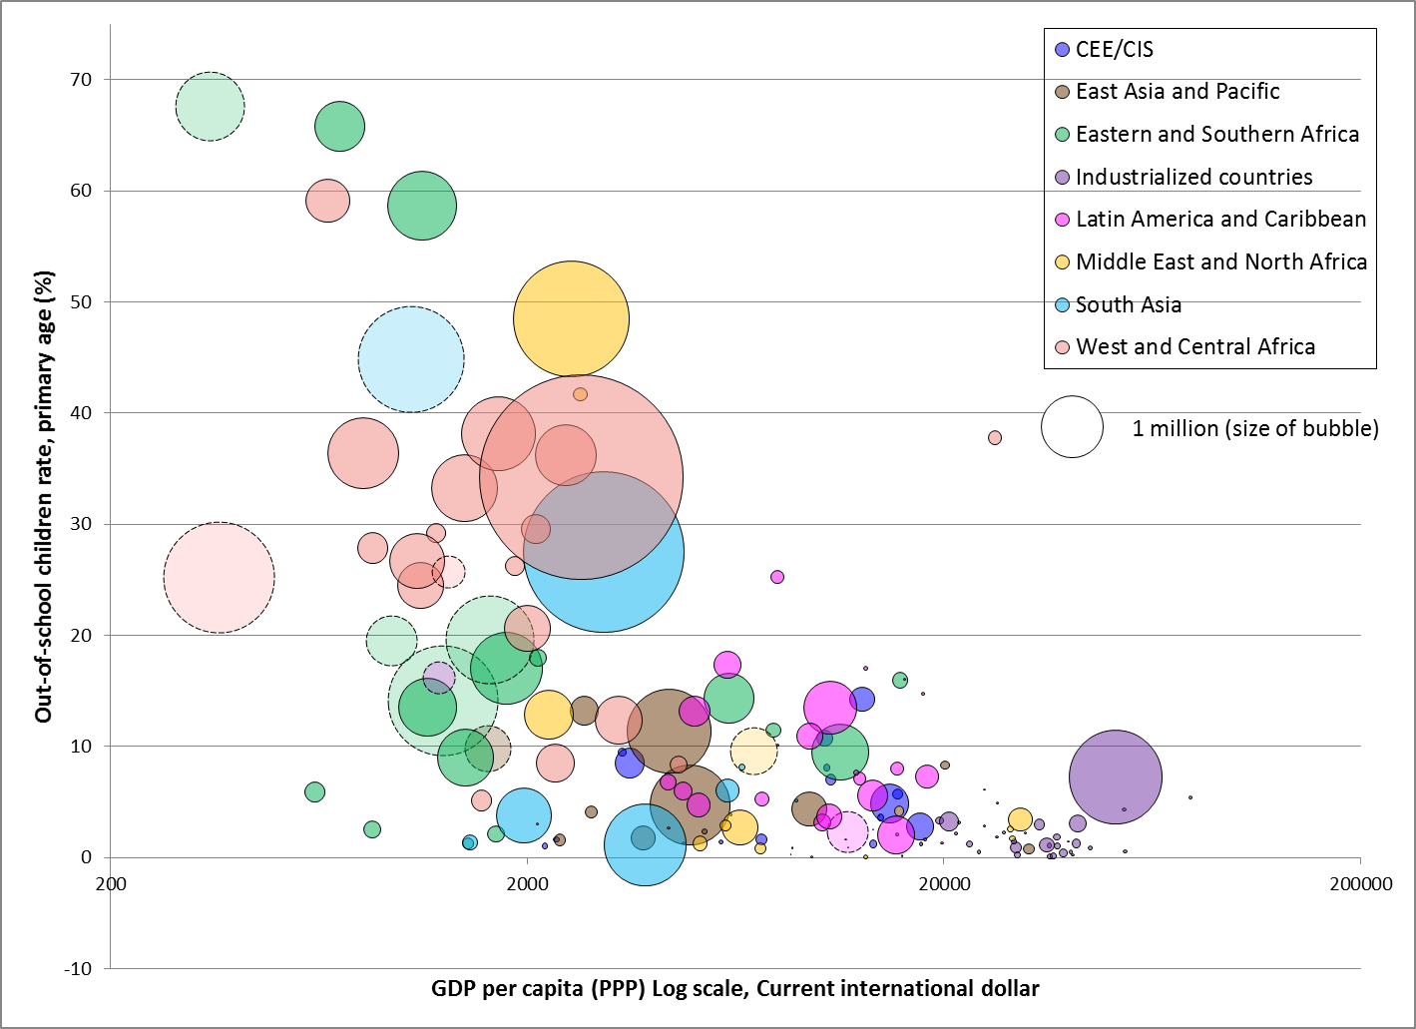
All countries

Slide 30
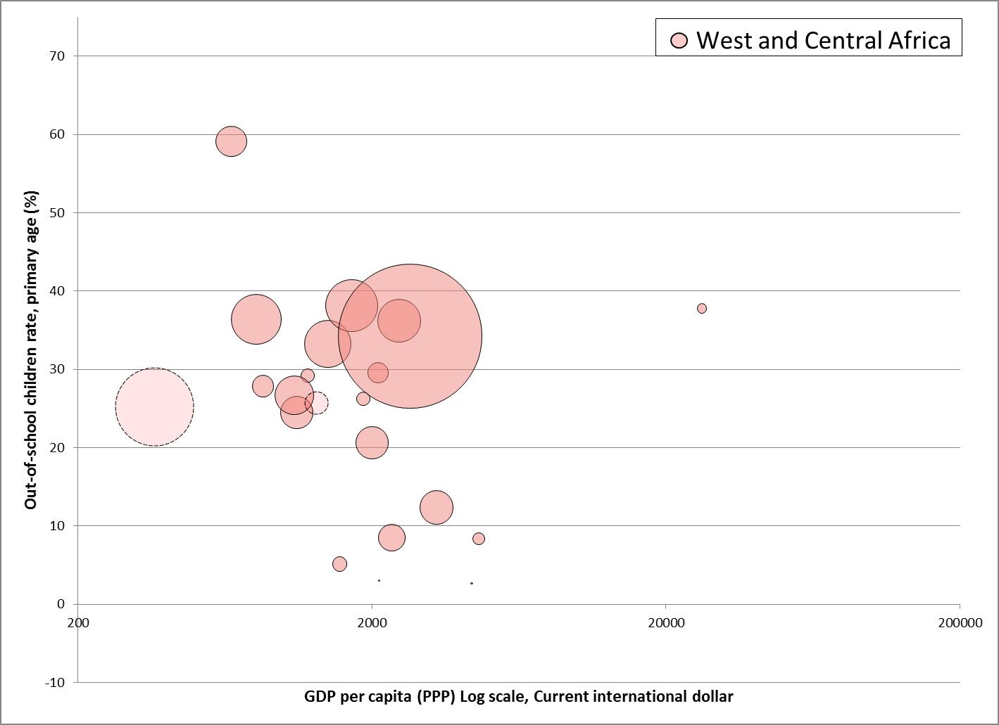

Slide 31
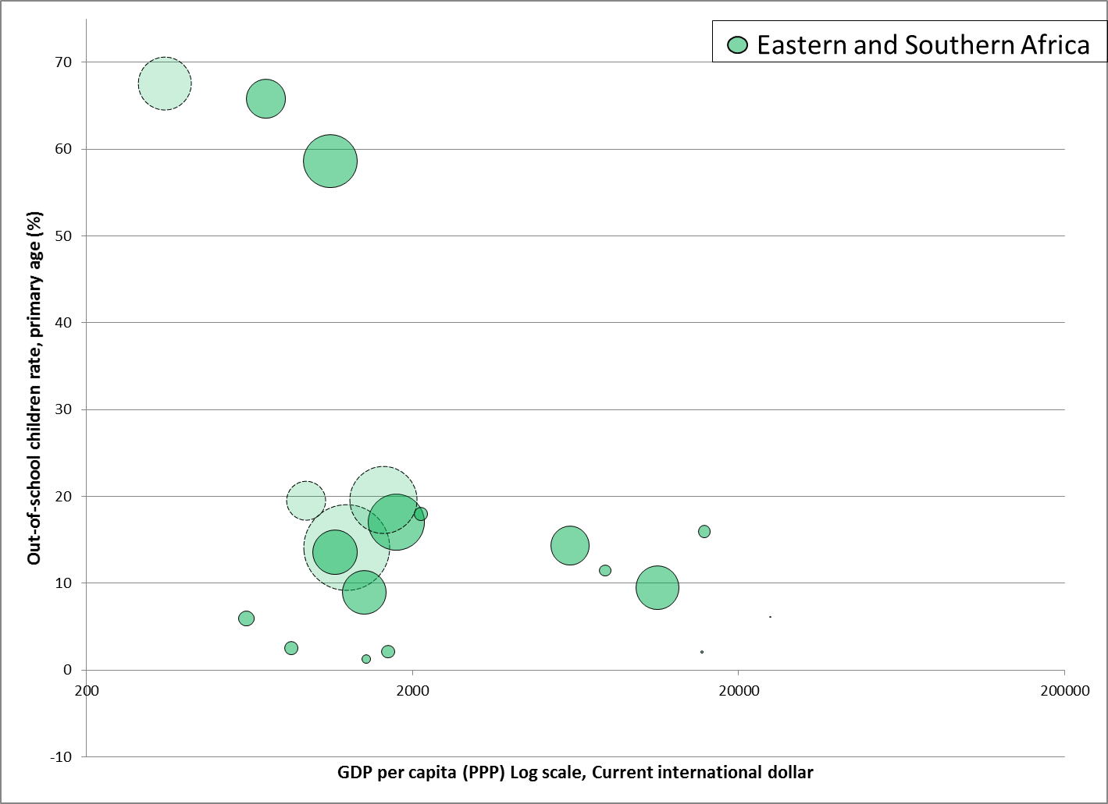

Slide 32
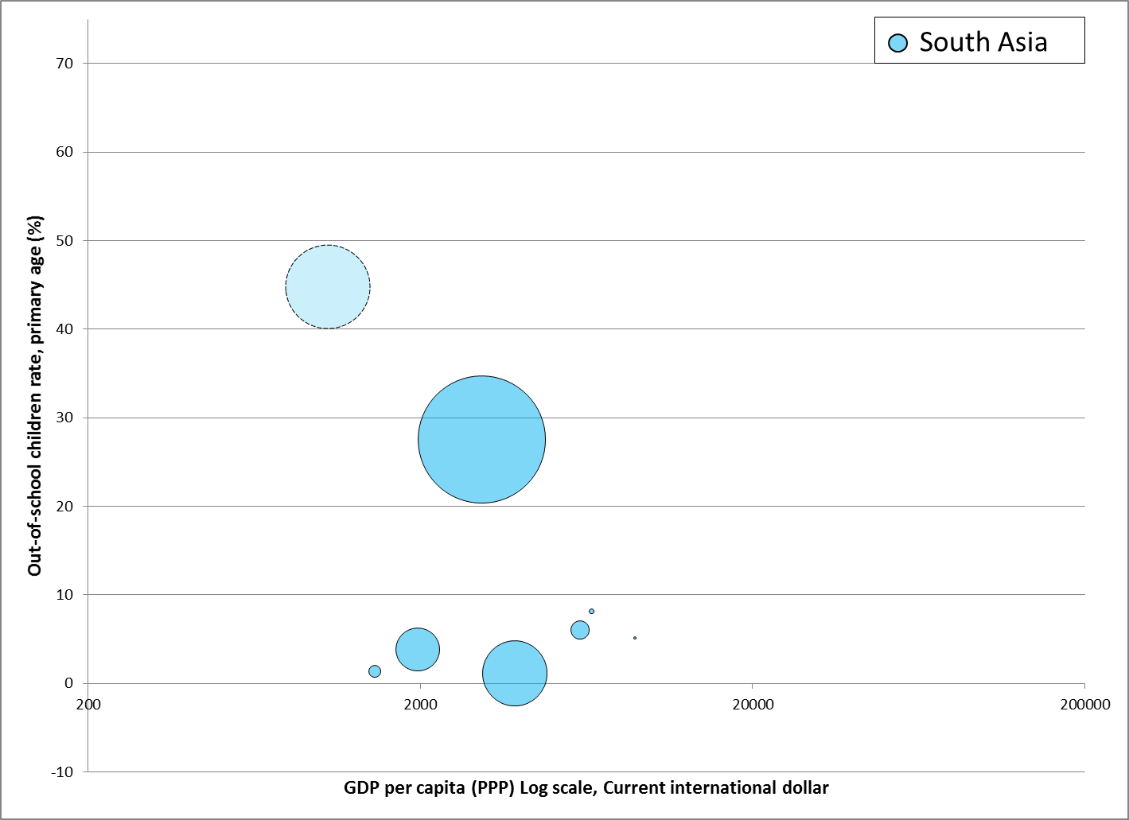

Slide 33
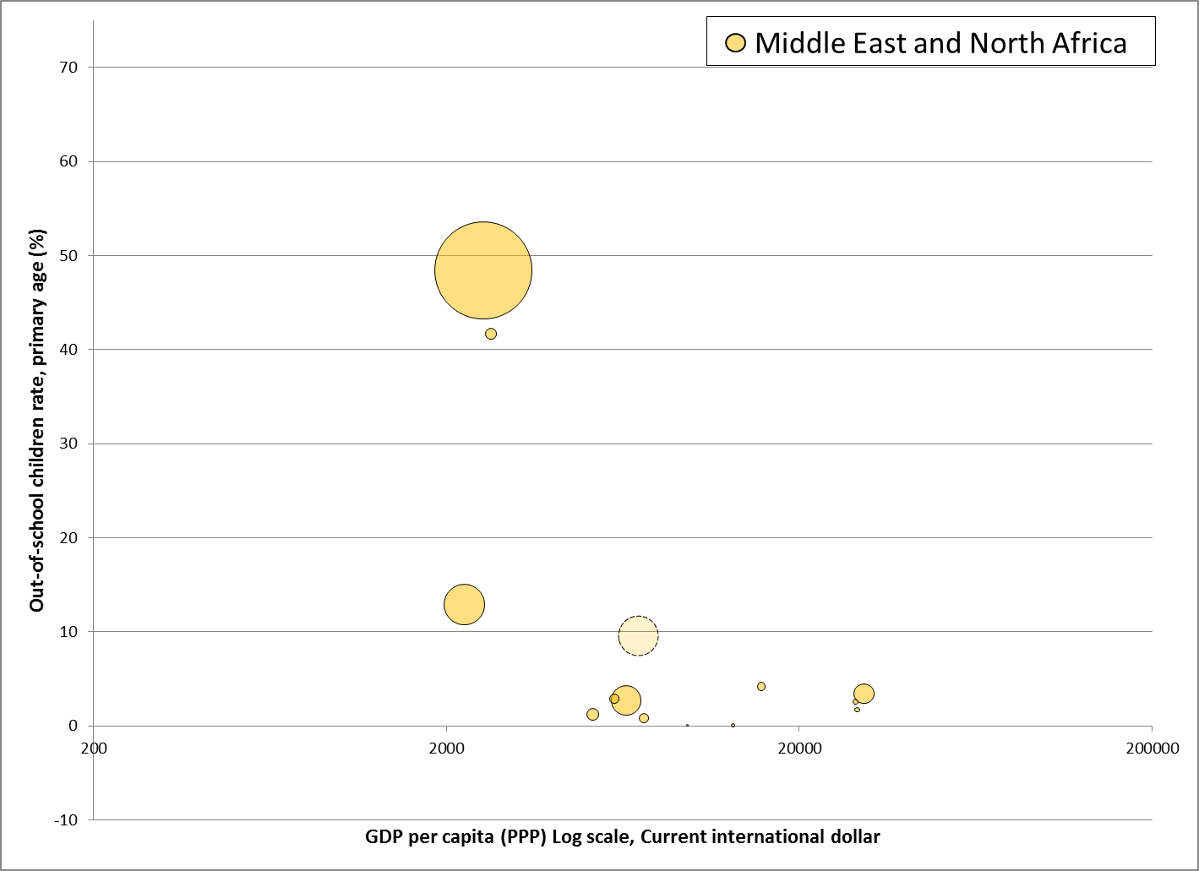

Slide 34
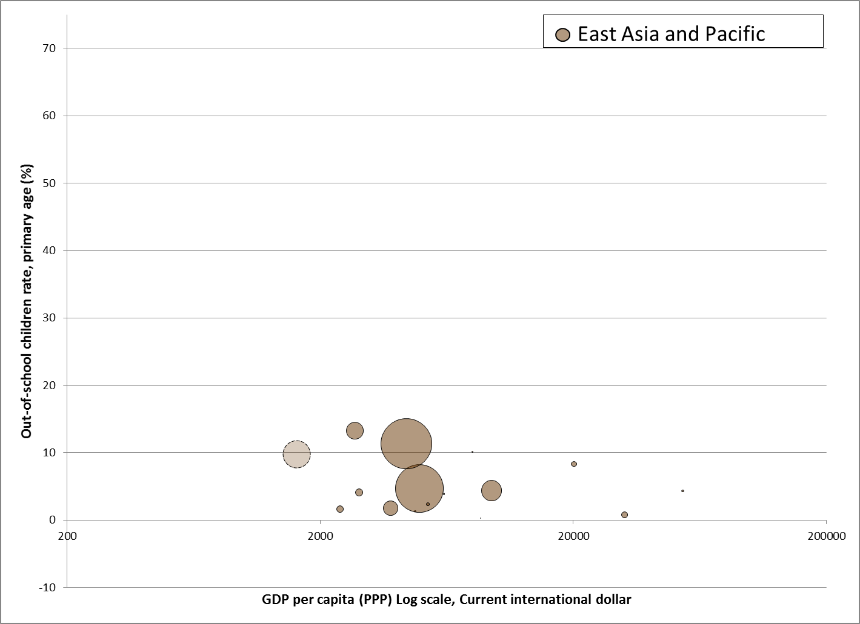

Slide 35
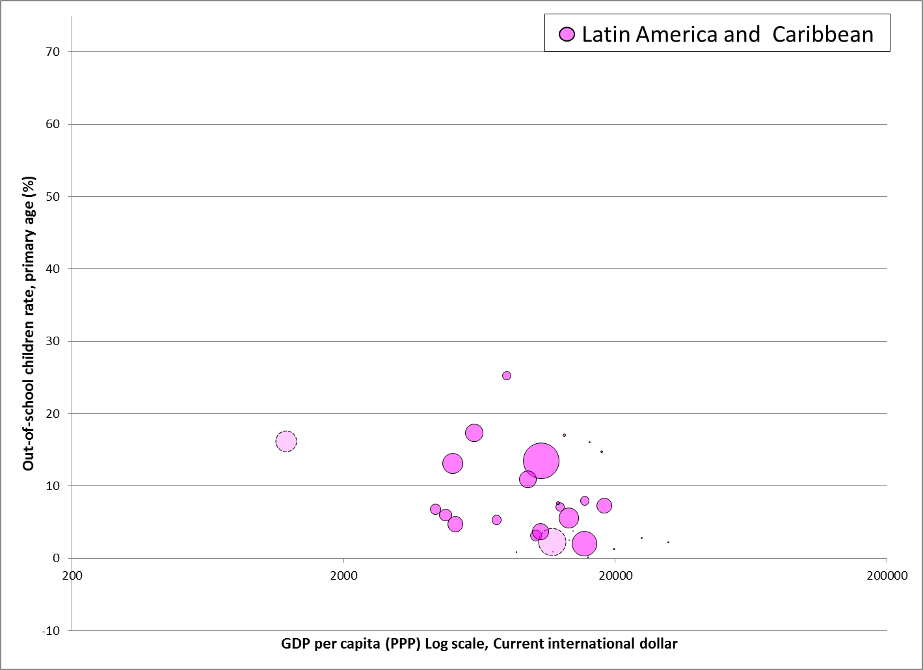

Slide 36
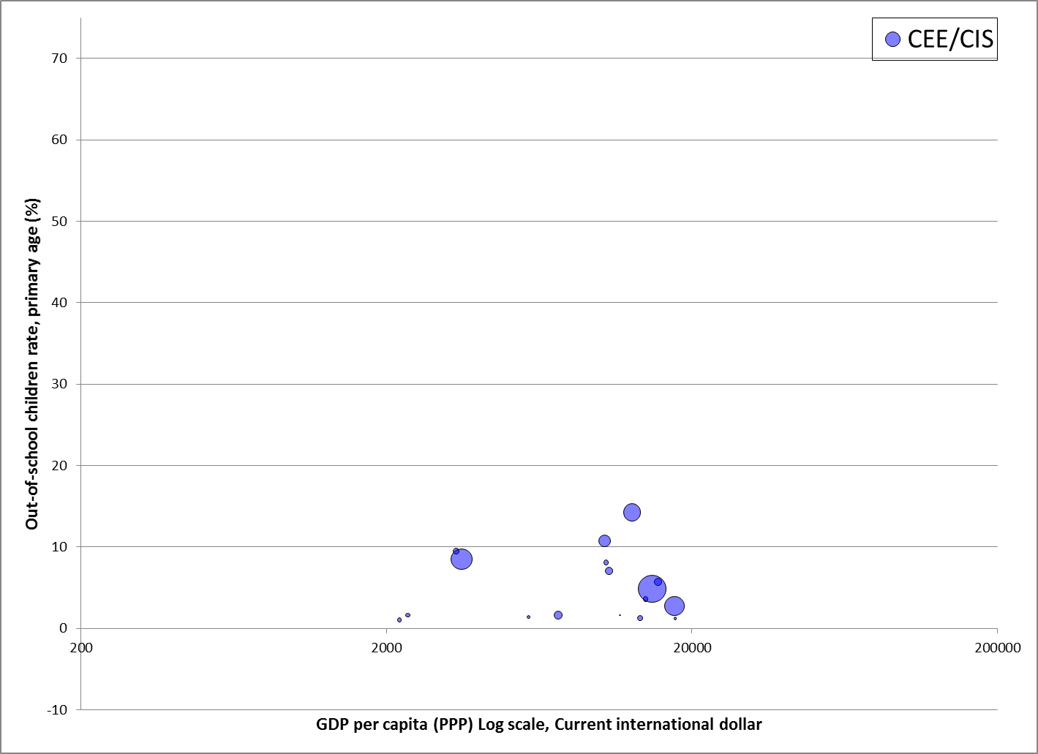

Slide 37
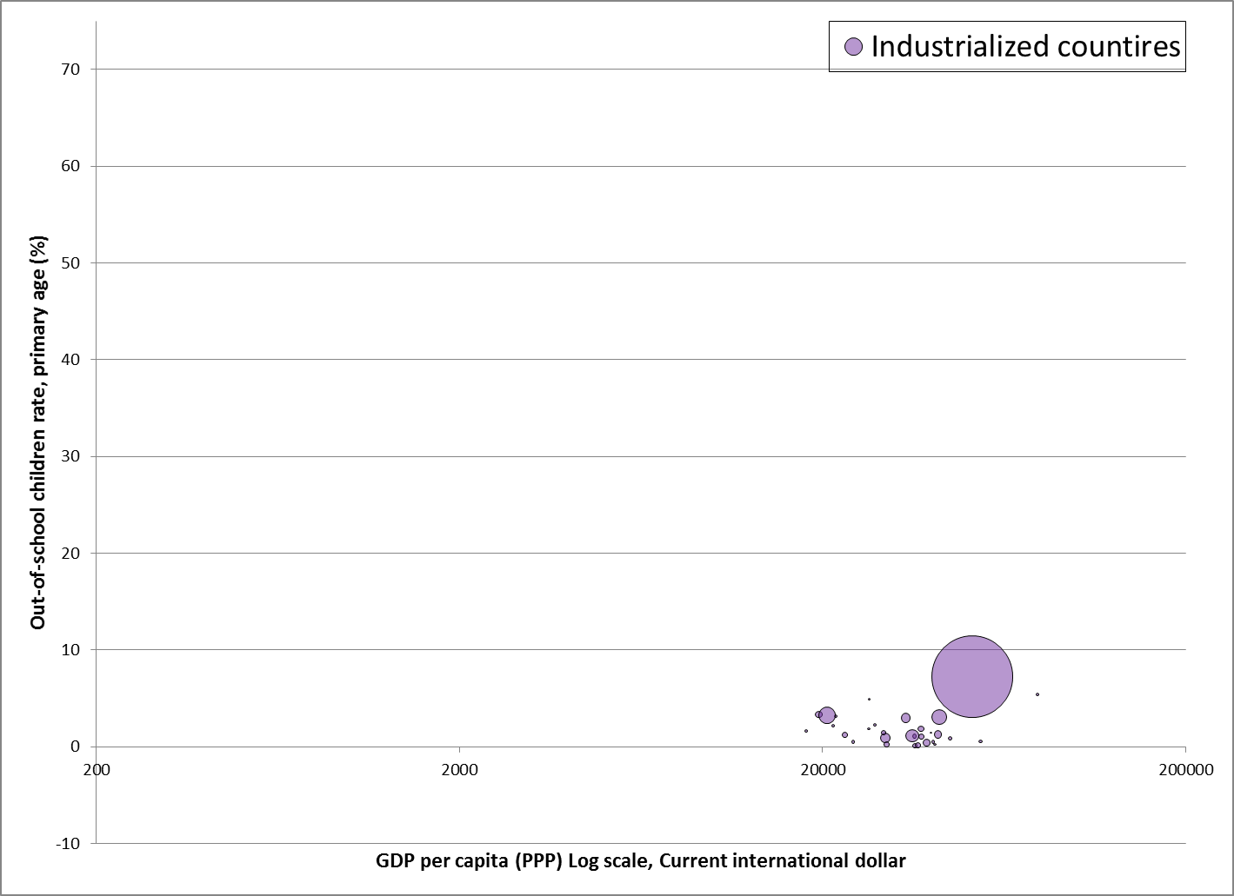

Slide 39
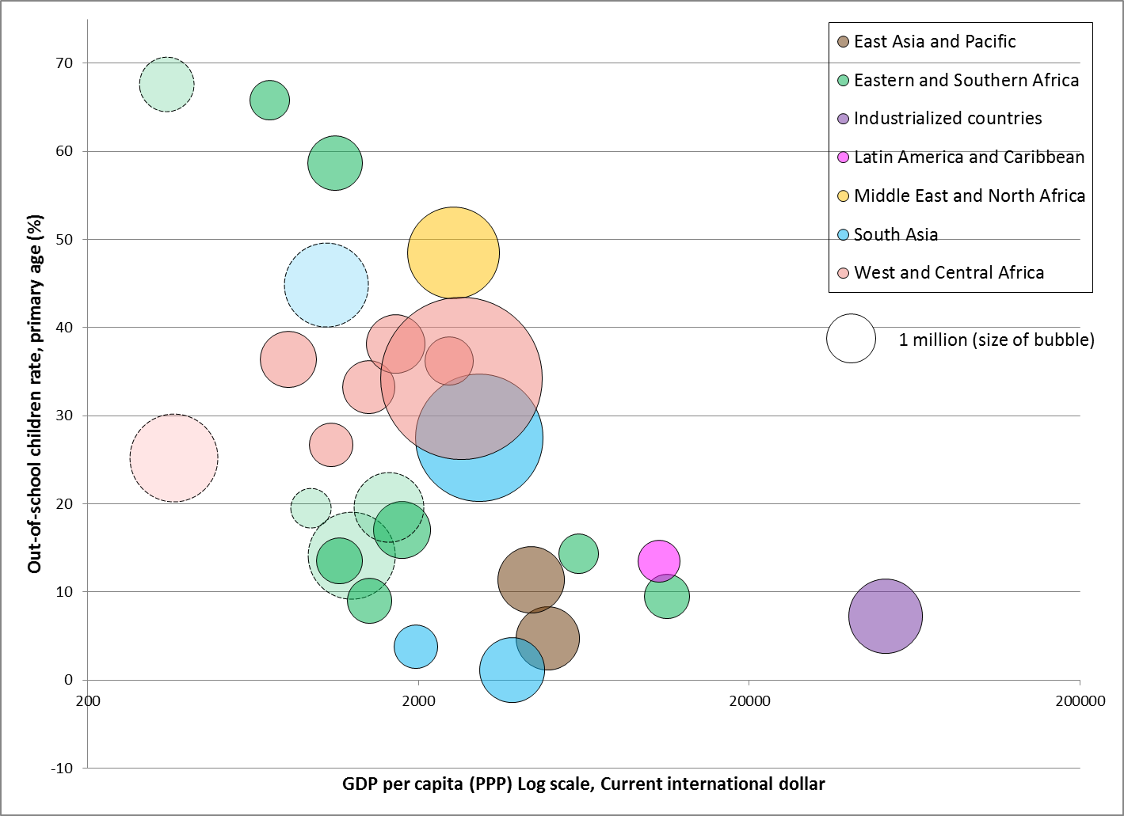
Sudan
Afghanistan
Nigeria
Pakistan
OOSC > 0.5 million
Democratic Republic of the Congo
Philippines
Ethiopia
United States
Indonesia
India
Notes:
Nigeria, Pakistan, DRC, Sudan, Afghanistan – what is common among these countries having the largest population of OOSC?

Slide 40
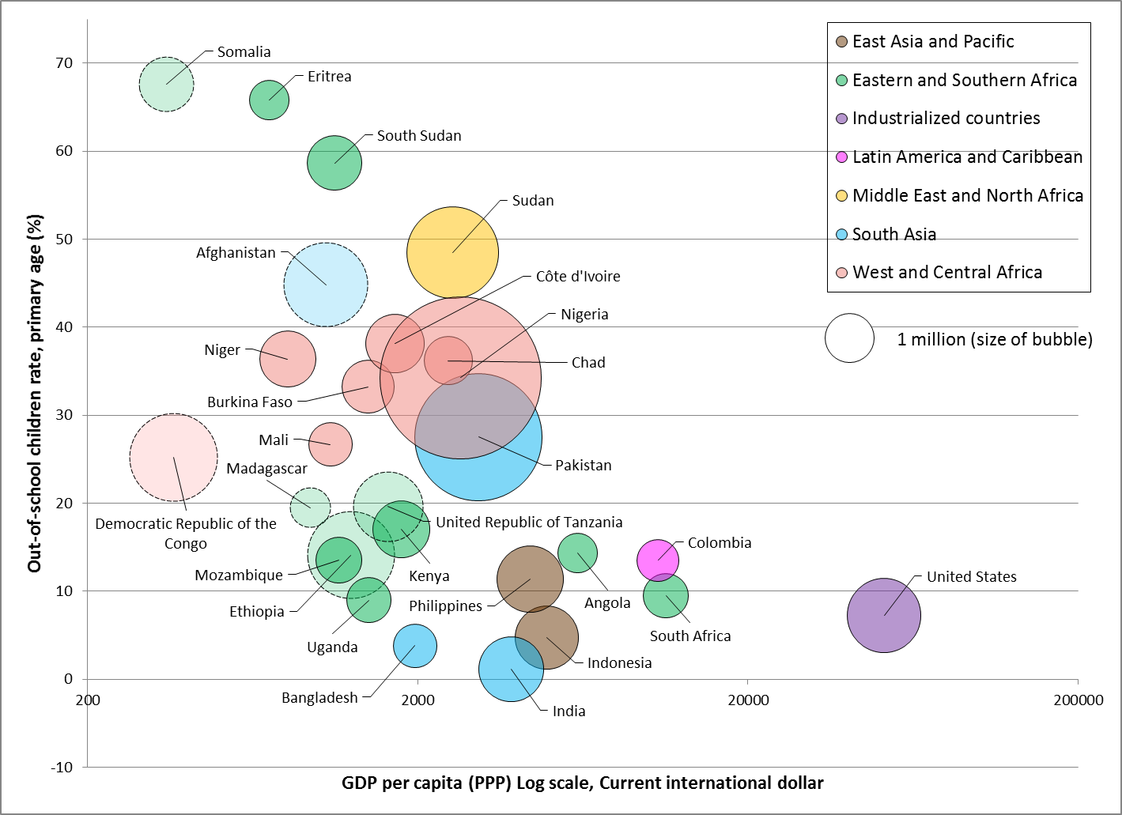
OOSC > 0.5 million

Slide 41
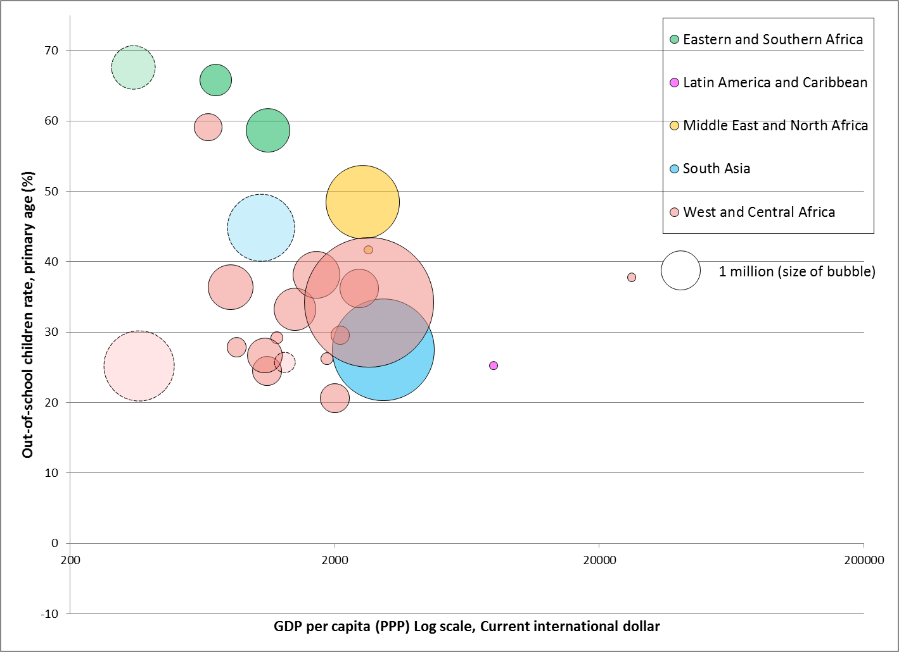
Somalia
Eritrea
South Sudan
Liberia
Sudan
Afghanistan
Djibouti
Nigeria
Equatorial Guinea
Guyana
OOSC rate > 20%
Democratic Republic of the Congo
Pakistan

Slide 42
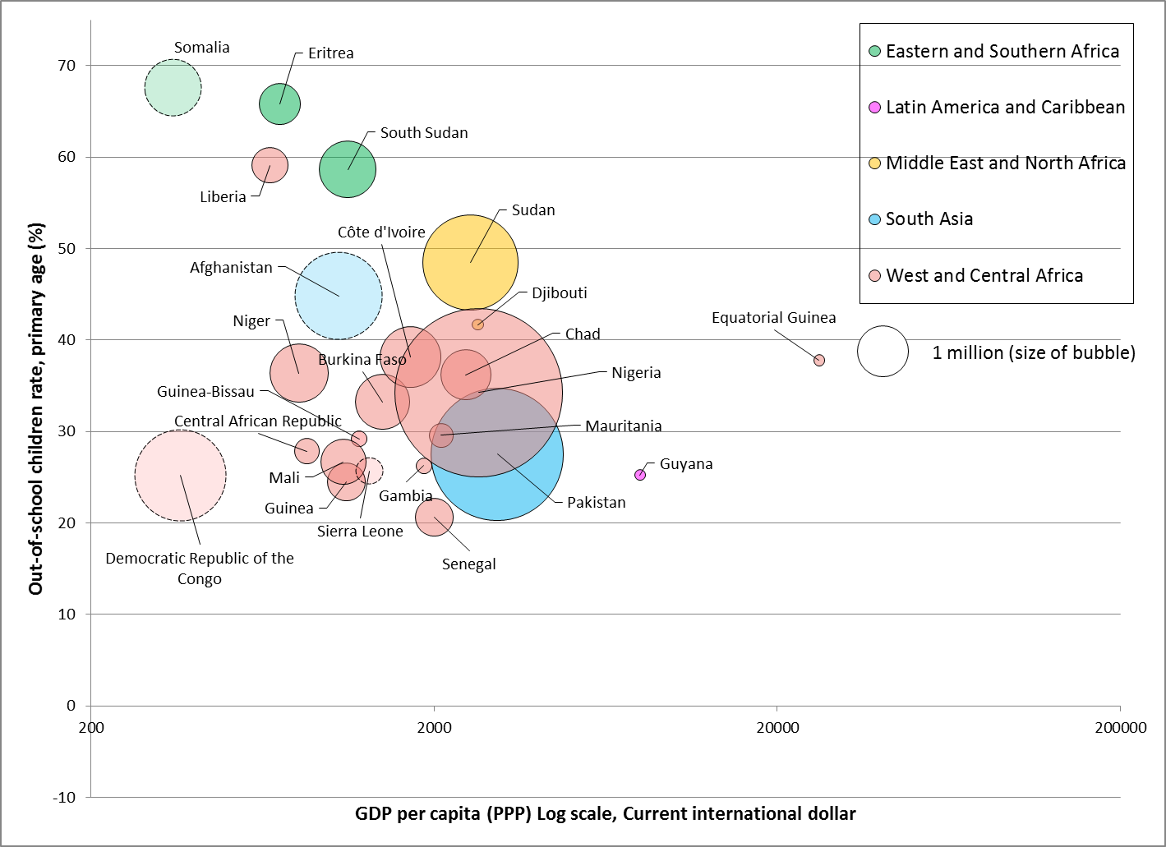
OOSC rate > 20%

Slide 43
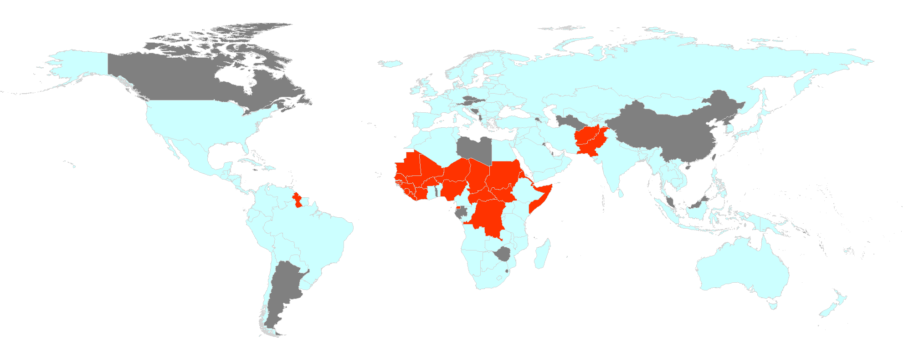
High proportions and numbers of OOSC concentrate in Horn of Africa and Western and Central Africa.
OOSC rate > 20%
Notes:
In West and Central Africa, still nearly one third of girls and a quarter of boys of primary school age are out of school.

Slide 44
Which children are out of school?
Headlines
50% of out-of-school children live in countries affected by conflict
50% of out-of-school children live in sub-Saharan Africa
53% of out-of-school children are girls
Amongst out-of-school children
43% will never enter school
34% will enter school late
23% will drop out early
Notes:
44
44
Intend to ask audience for reasons why children enter late and drop out early.

Slide 45
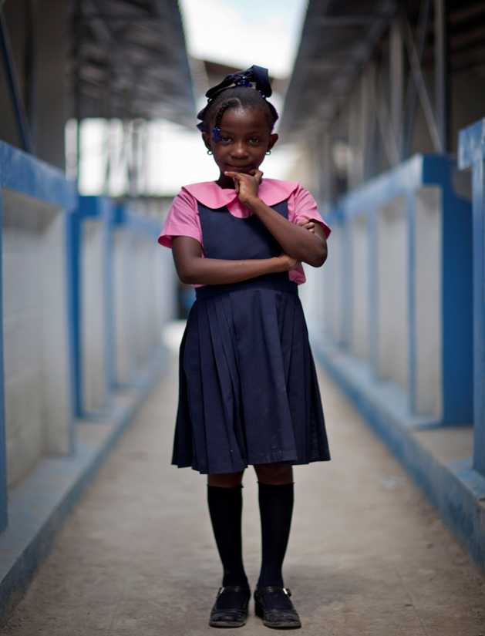
Who are these children?
More likely to be out of school:
Children from the poorest families
Children affected by conflict or natural disasters
Girls
Children with disabilities
Children from rural areas
Working children
Children from minority ethnic or language groups
Notes:
45

Slide 46
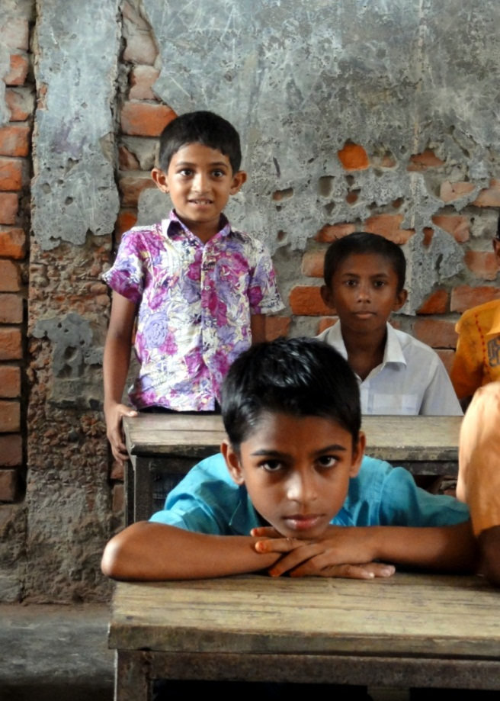
Why are they out of school?
Most common barriers:
Cost of going to school
Gender bias in culture or school system
No schools nearby
Schools don’t accept children with disabilities
Security
No jobs after finishing school
Language of instruction
Notes:
46

Slide 47
What policies can get children into school?
Profile
Barrier
Policy options
Girls from poor rural areas
Cultural practices
Campaigns or legislation
Distance
Satellite schools
Cost
Abolish all fees
Infrastructure
New funding formula
Children with disabilities
Cultural bias
Campaigns
Accessibility
Building regulations
Children > 1 yr over age
Late entry
Increase ECD
Repetition
Automatic promotion
Notes:
47
47
Final recommendation is most important. Deprived areas, groups, etc need more resources ... See next slide

Slide 48
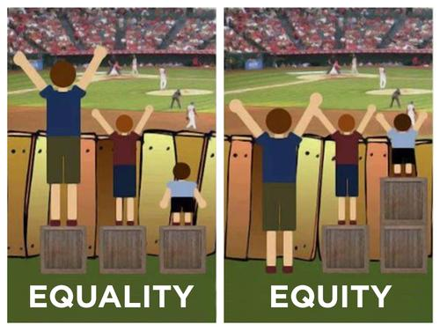
Why is equity important?
Notes:
48
48

Slide 49
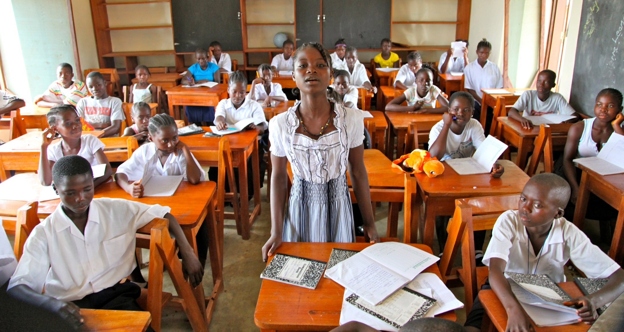
Thank you
Notes:
49

