Slide 1
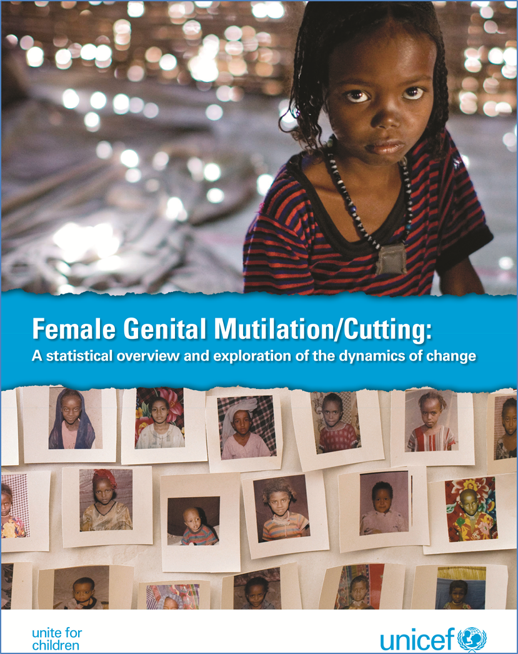
Key findings
Claudia Cappa
Statistics and Monitoring Section/DPS, UNICEF
22 July 2013

Slide 2
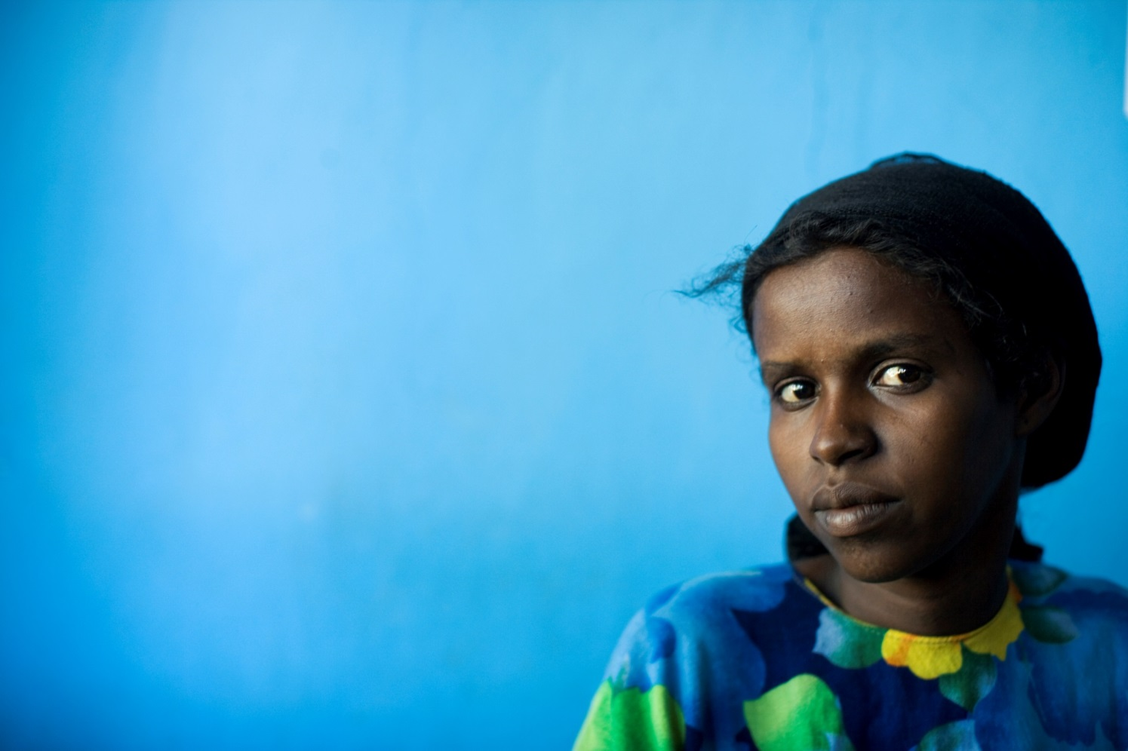
How widespread is the practice?

Slide 3
Some numbers
More than 125 million girls and women alive today have been cut
Of these, 1 in 5 live in just one country: Egypt
30 million girls are at risk of being cut in the next decade

Slide 4
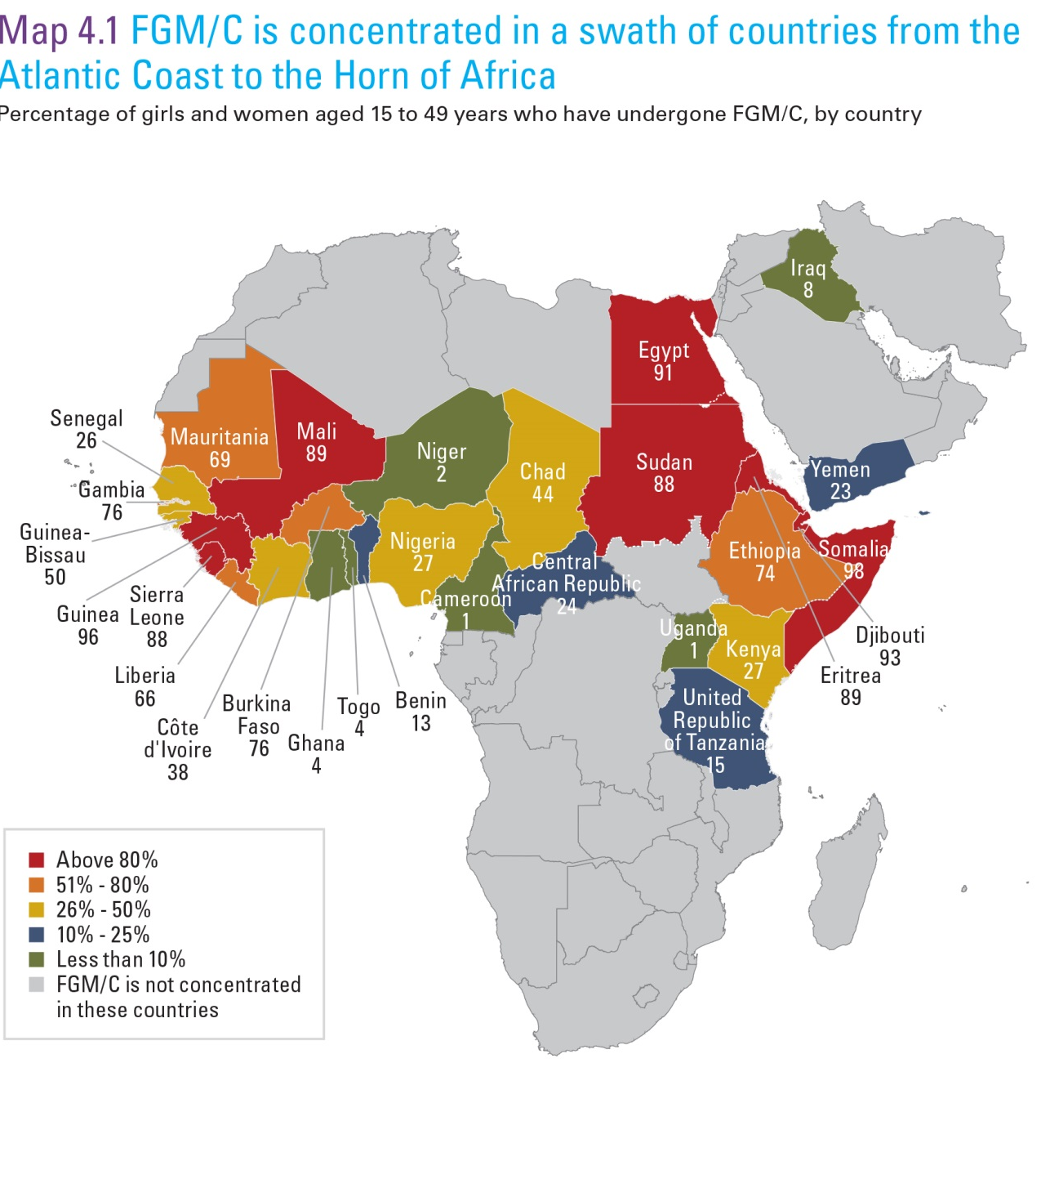

Slide 5
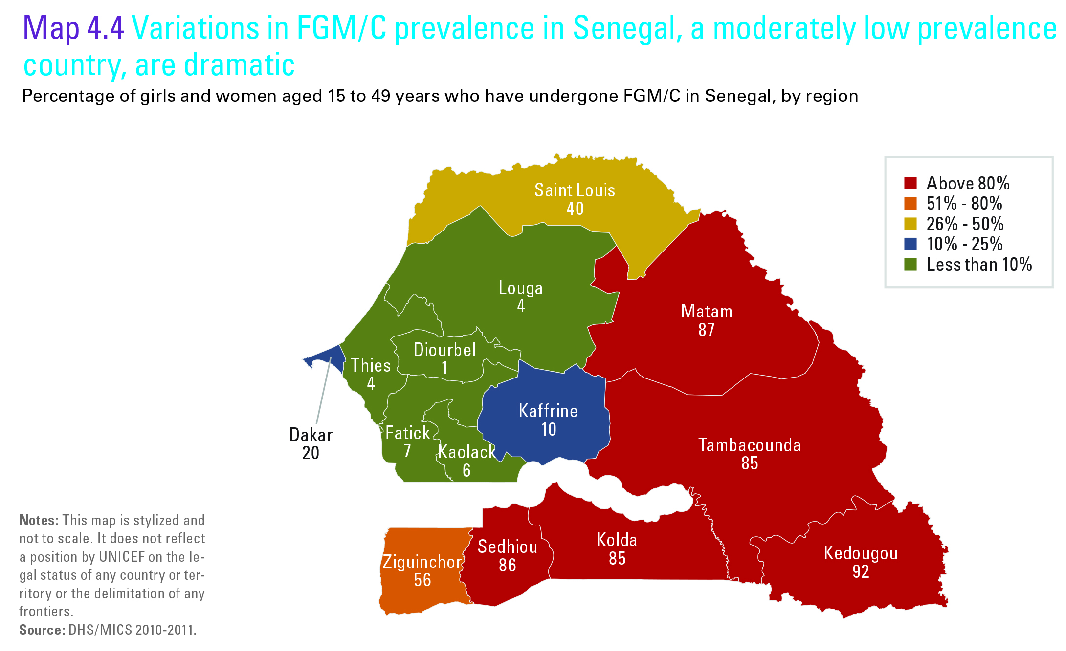
National prevalence: 26%

Slide 6
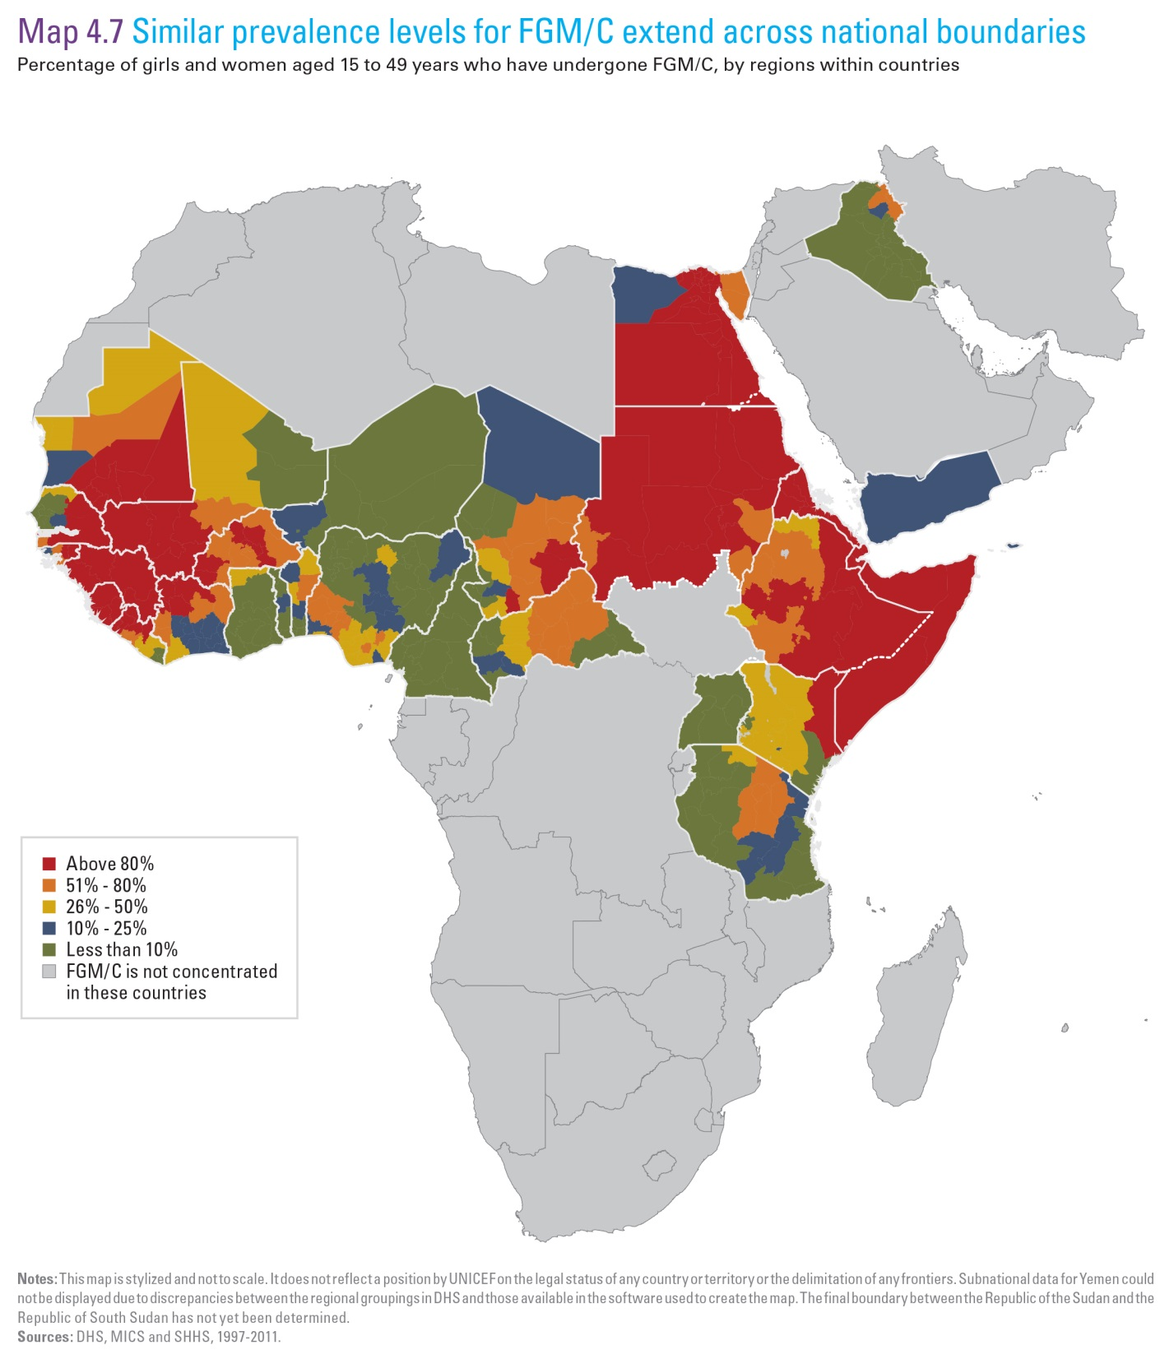

Slide 7
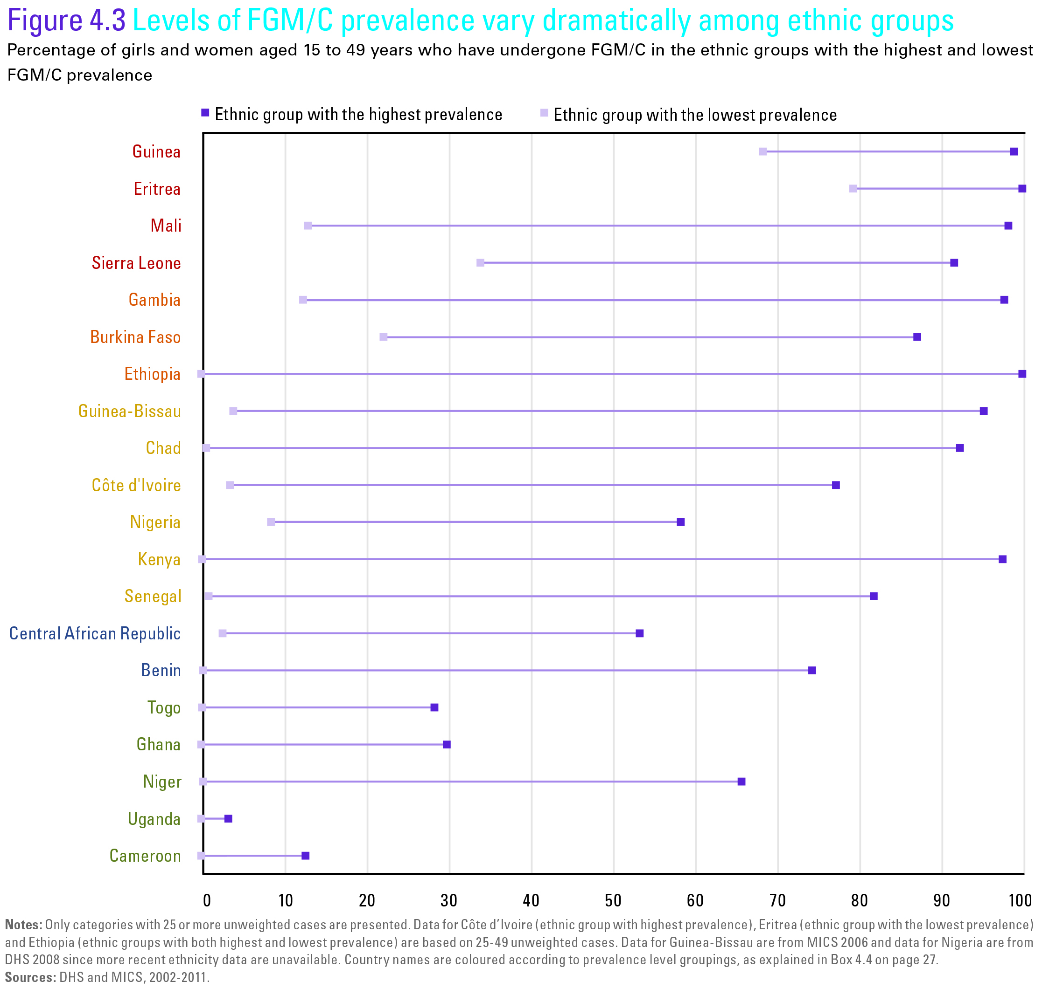

Slide 8
When and how is FGM/C performed?

Slide 9
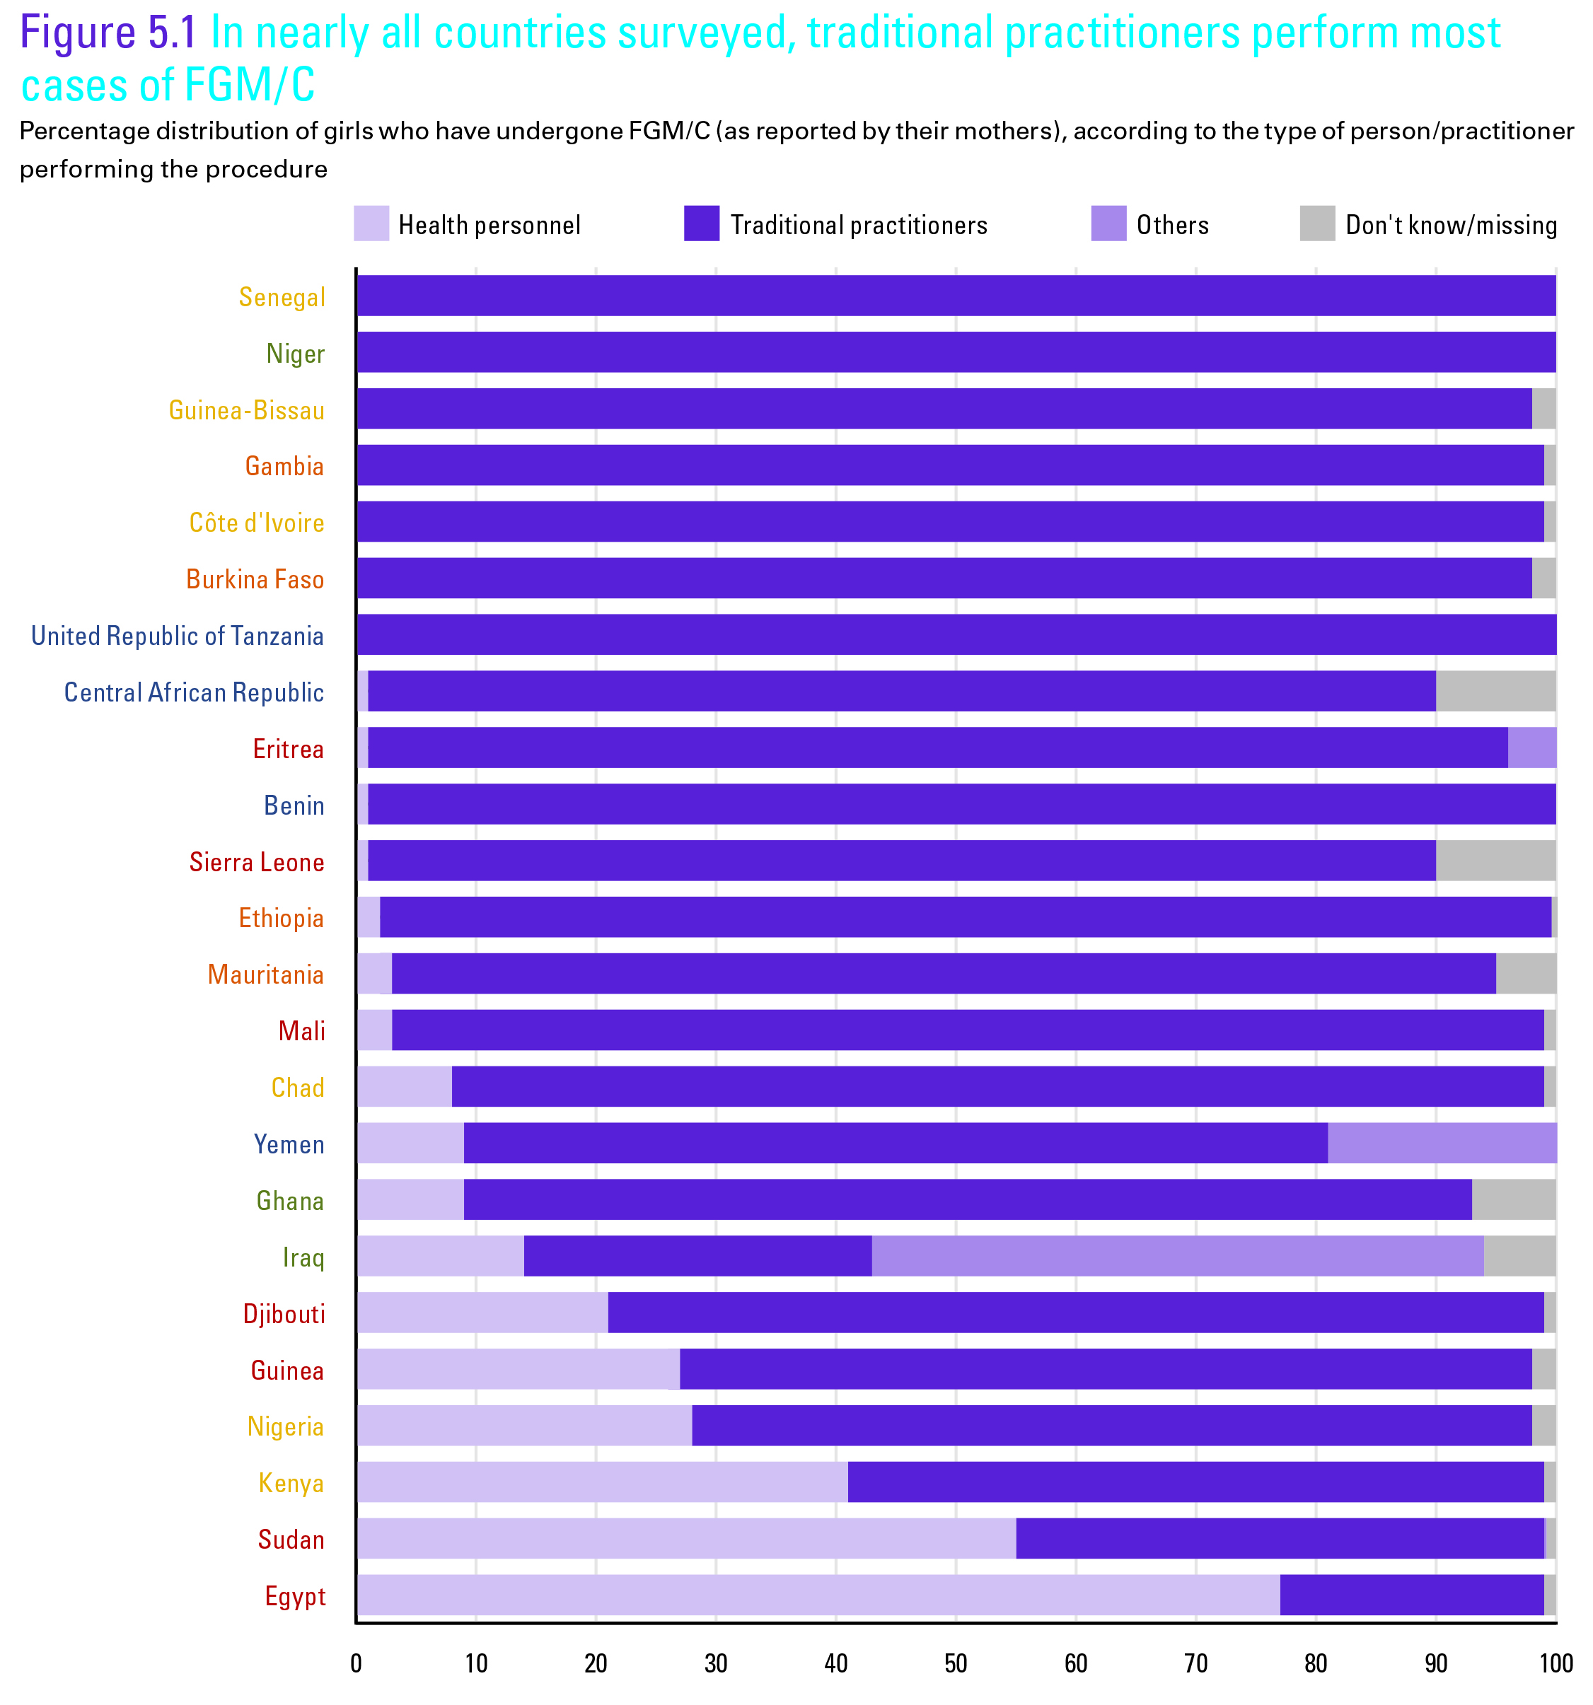

Slide 10
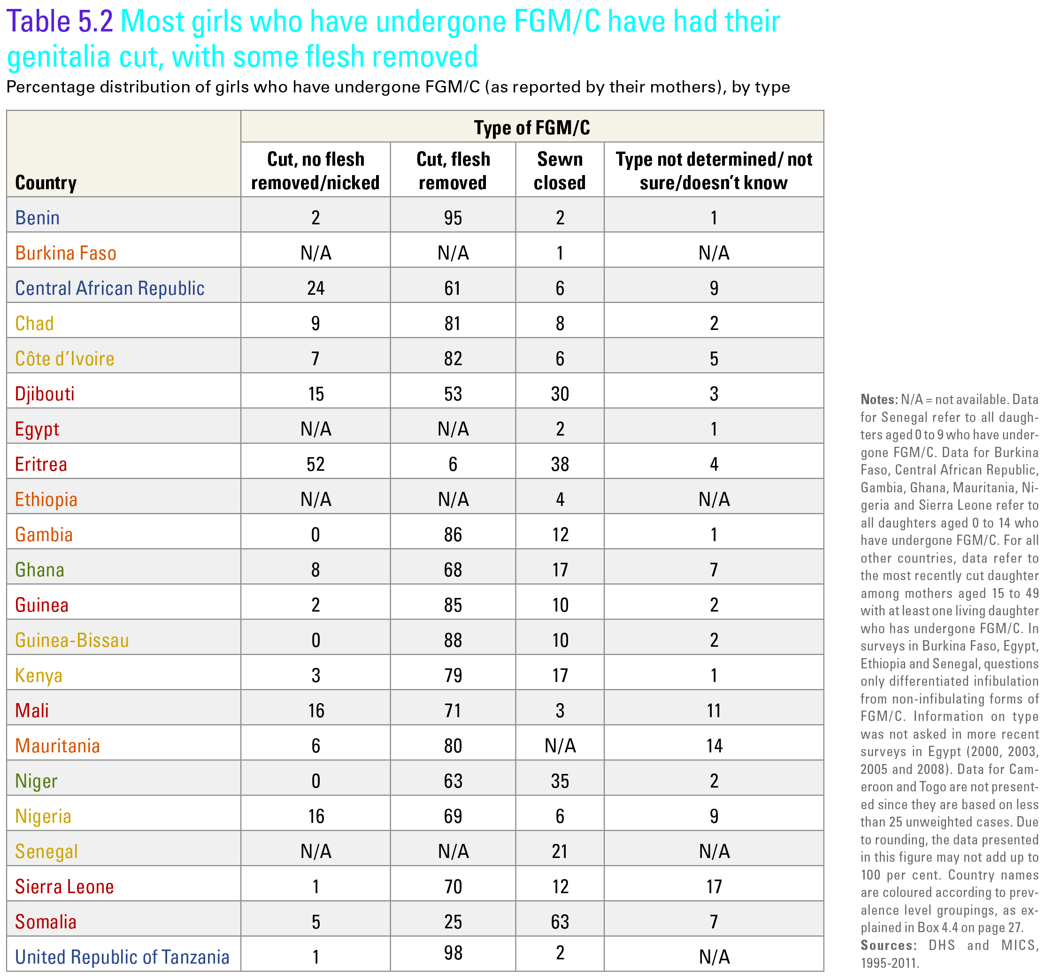

Slide 11
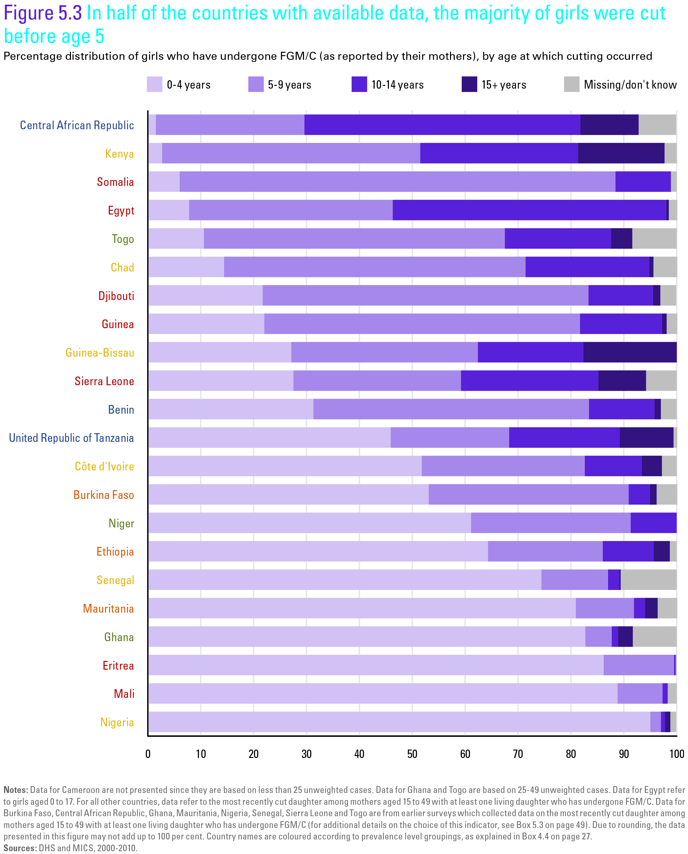

Slide 12
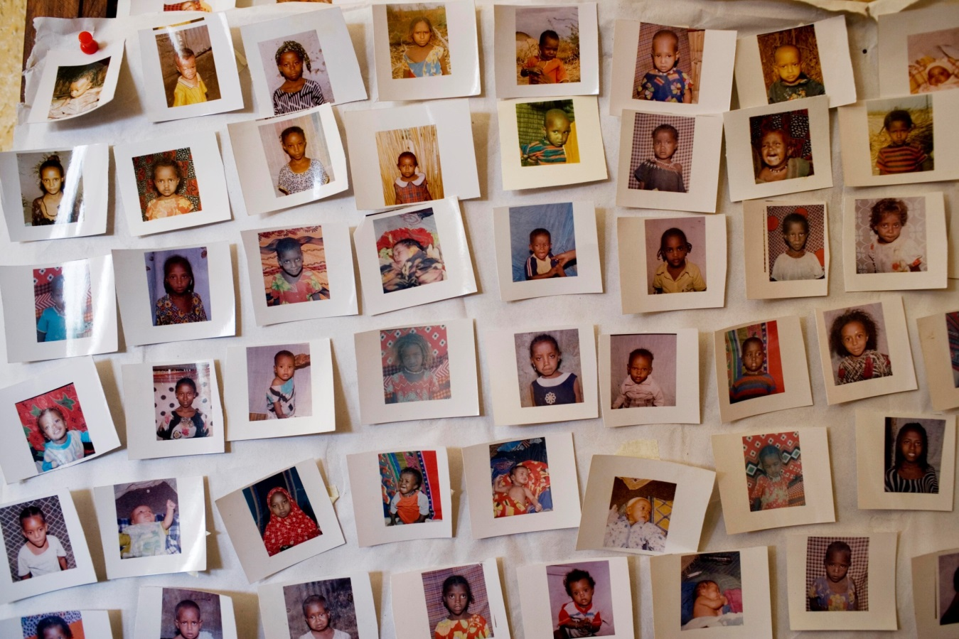
What are the prevailing attitudes towards FGM/C?

Slide 13
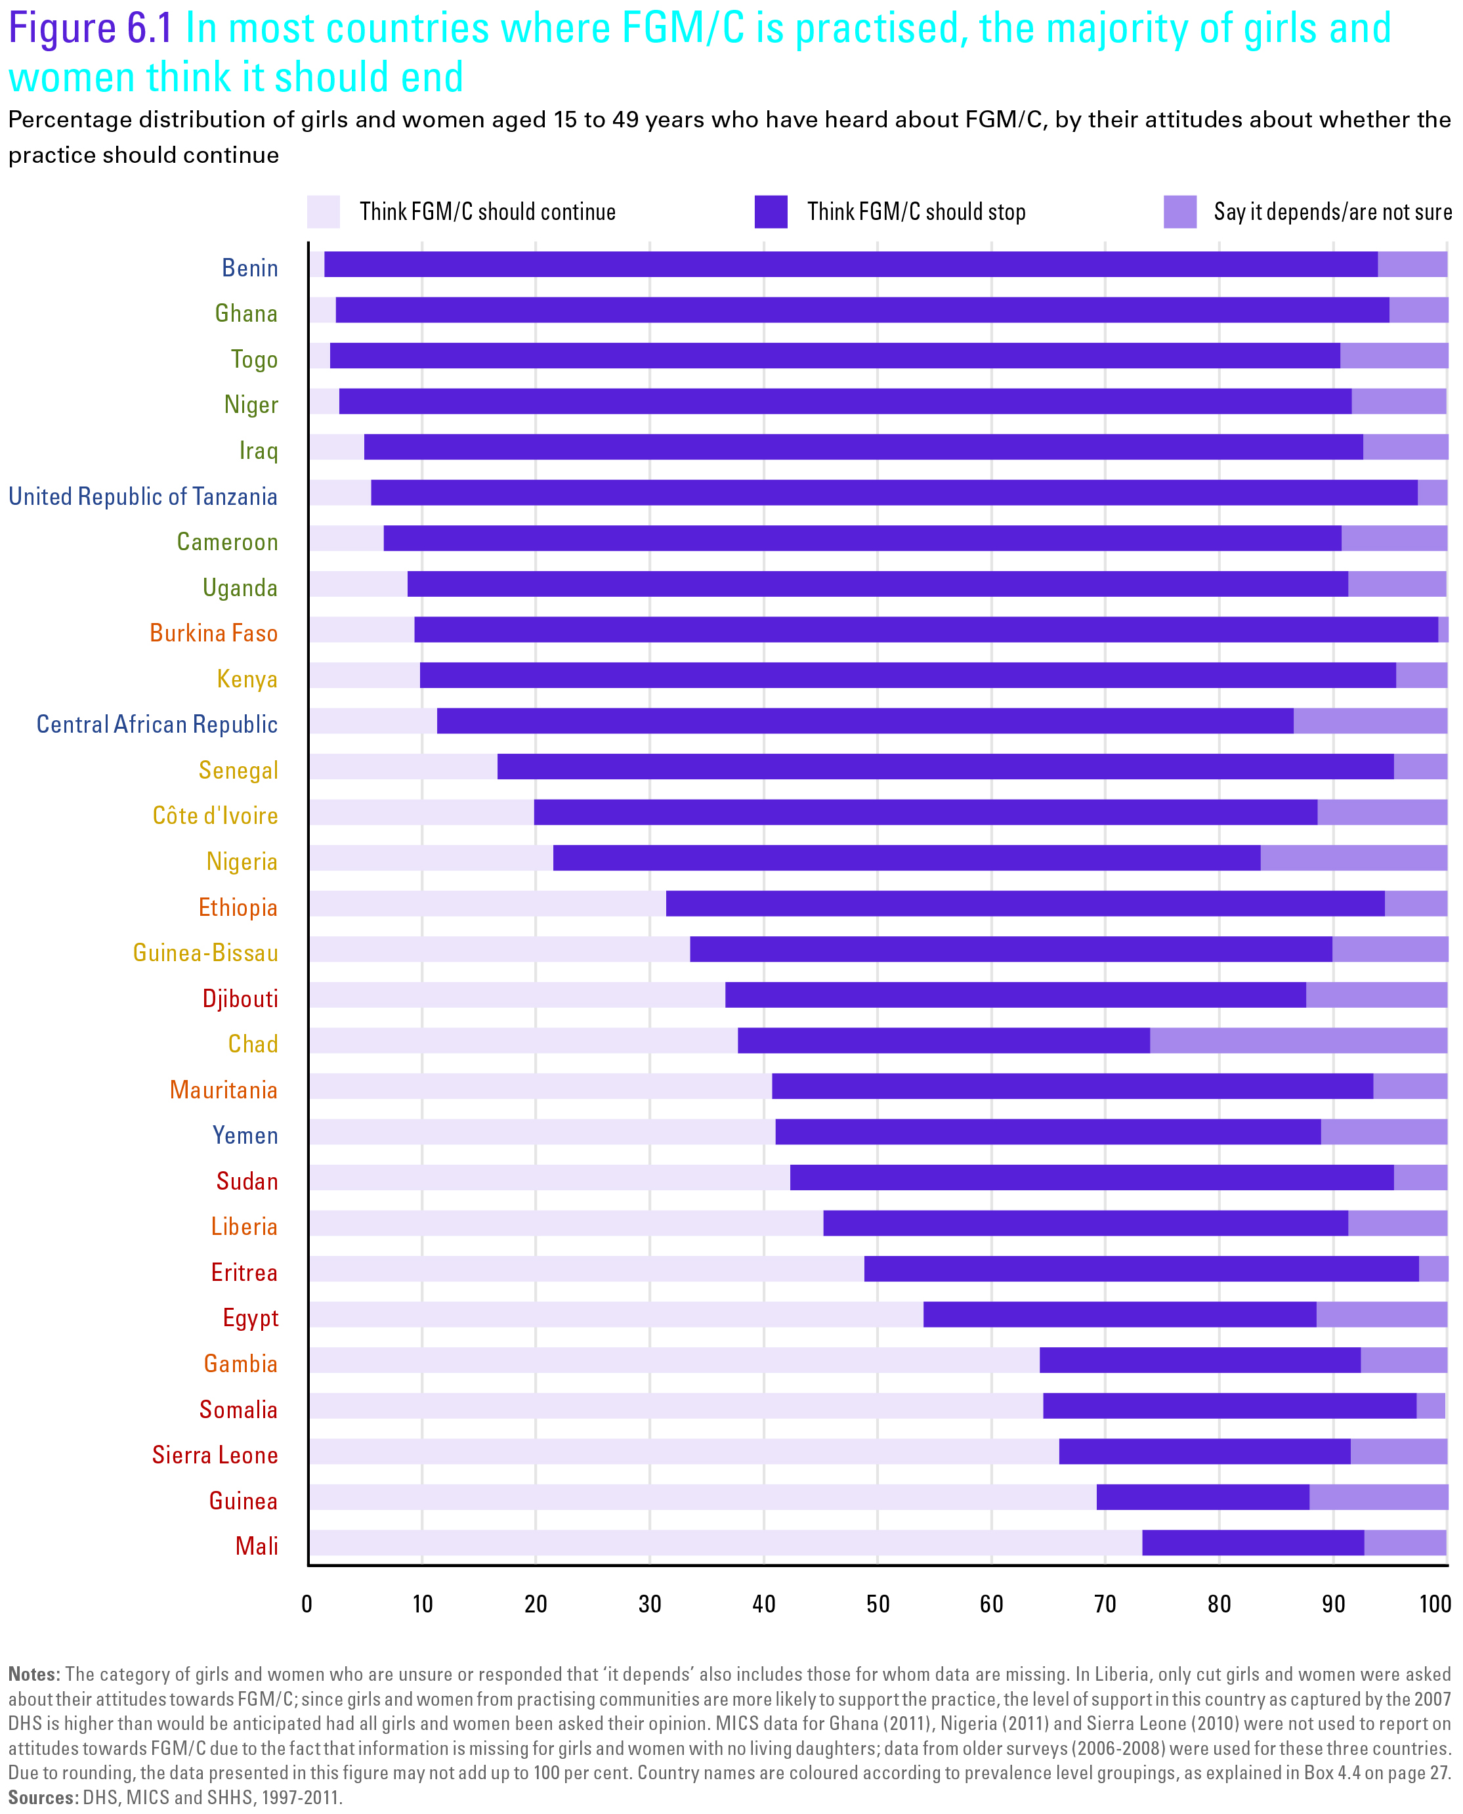

Slide 14
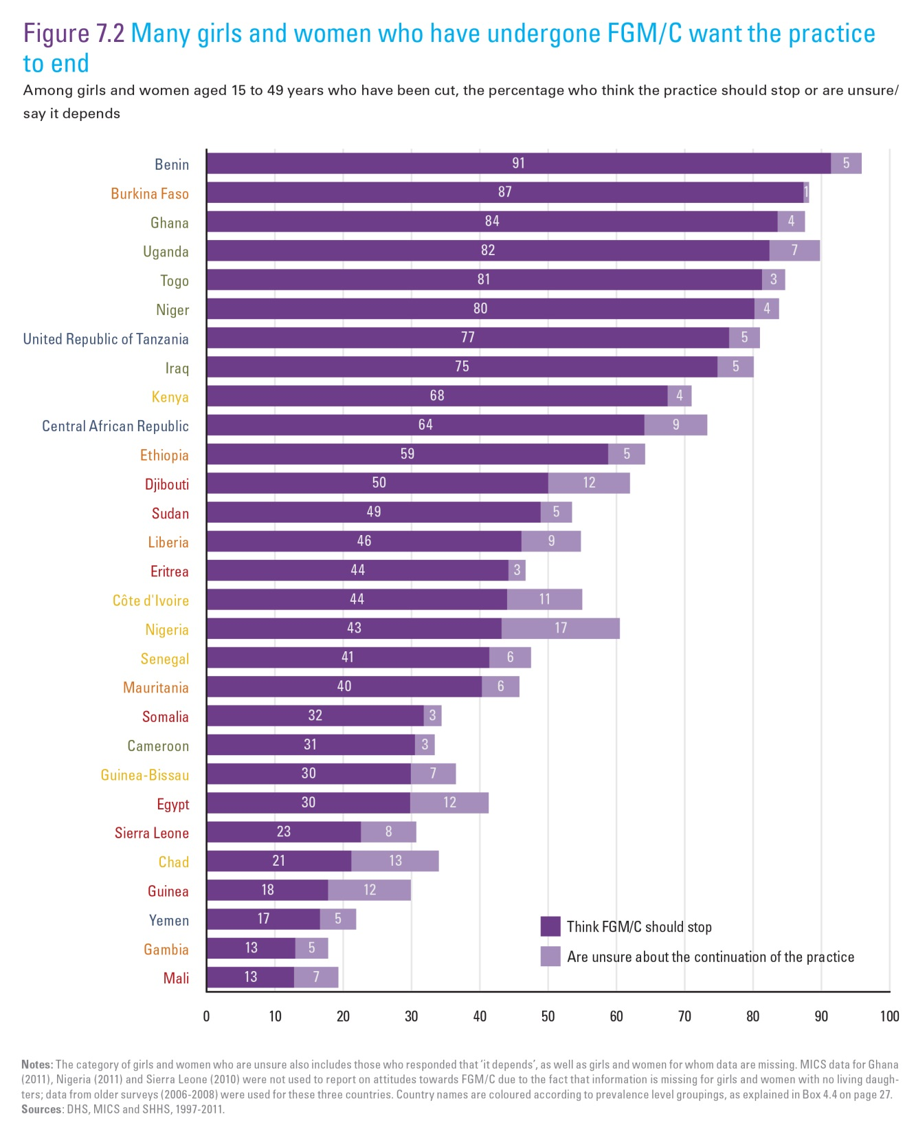

Slide 15
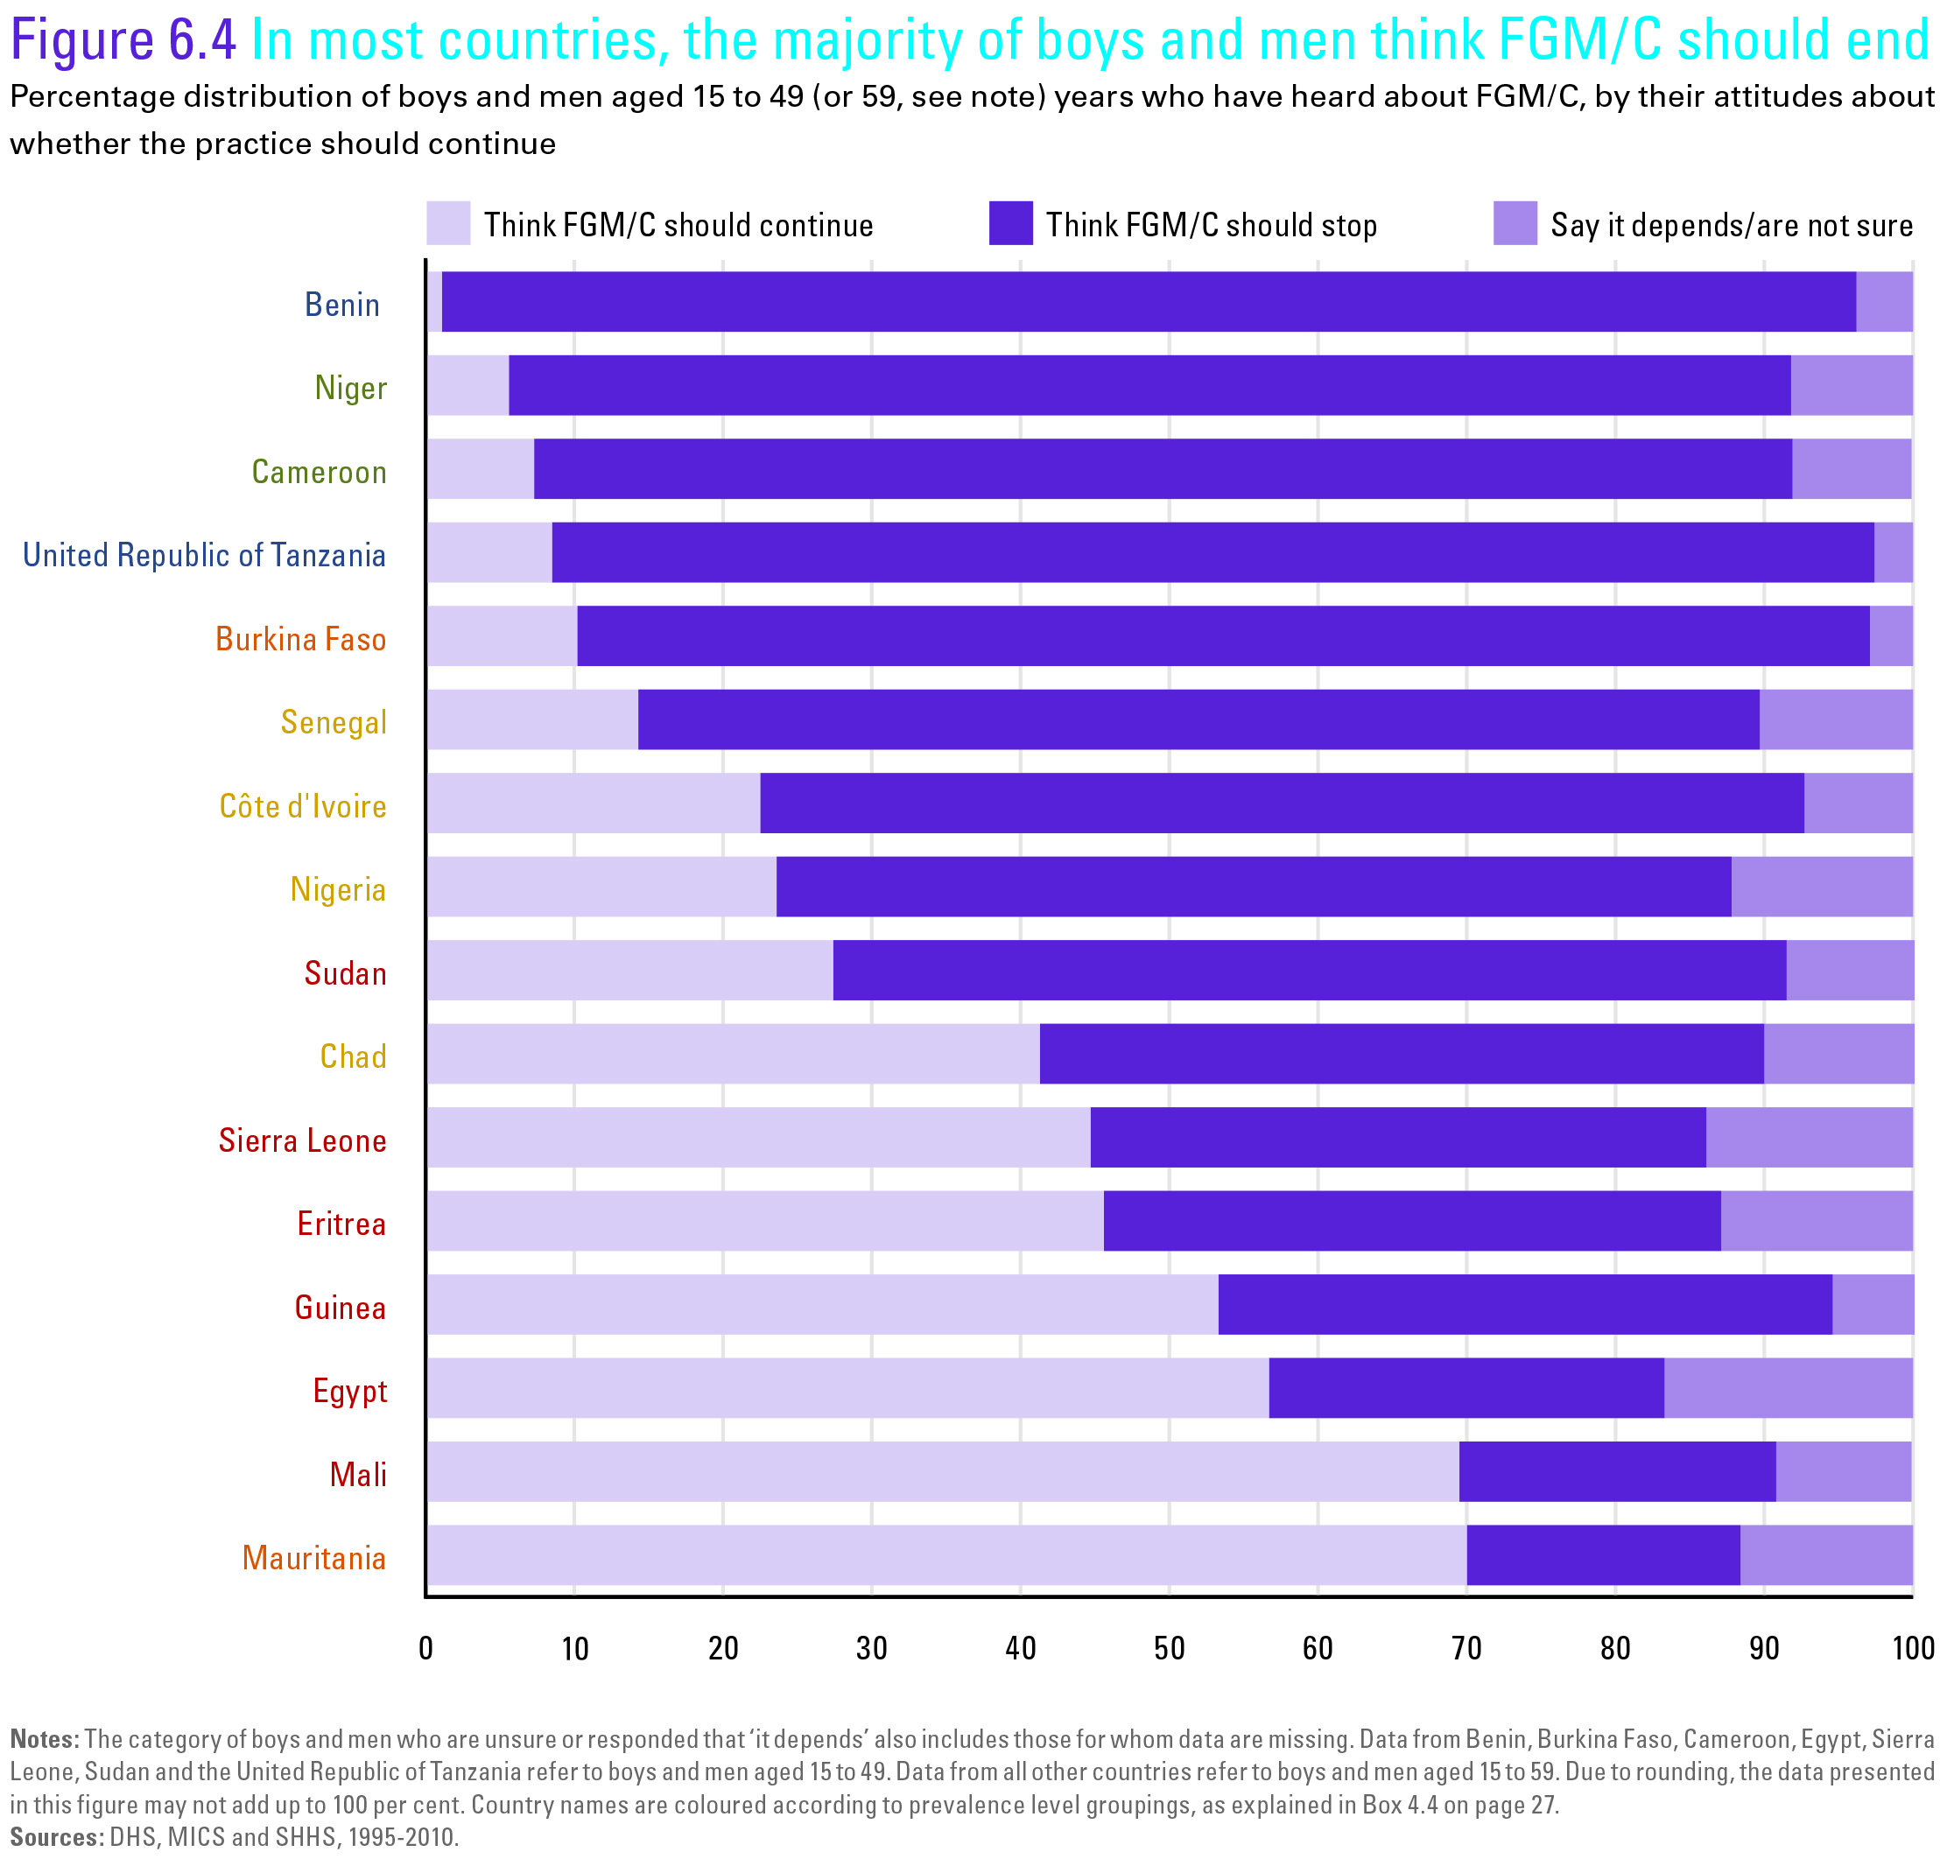

Slide 16
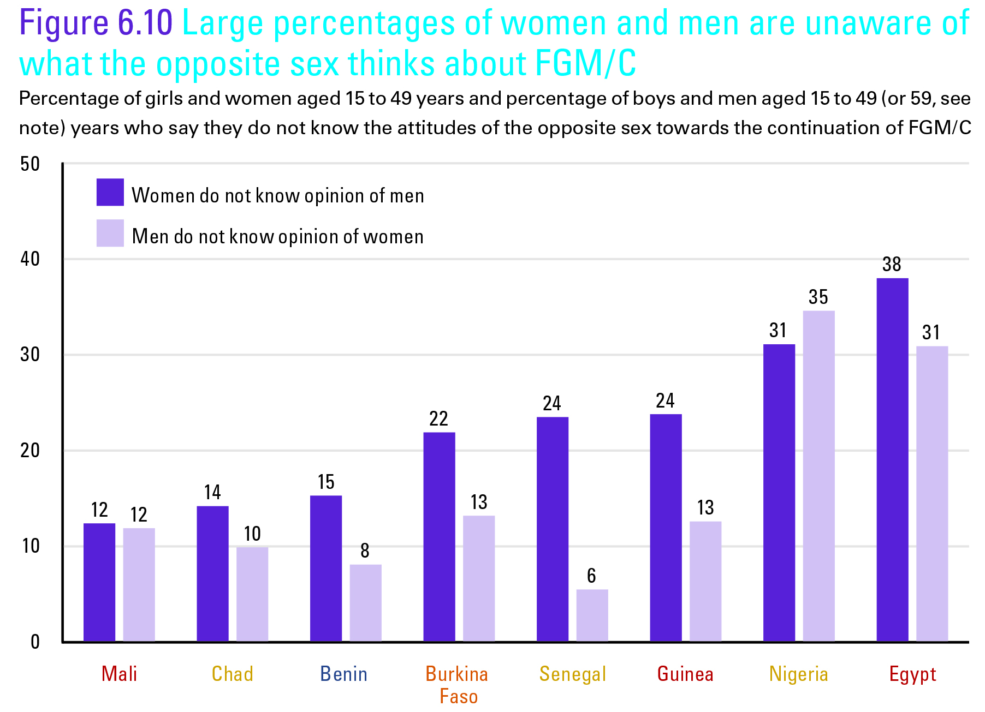

Slide 17
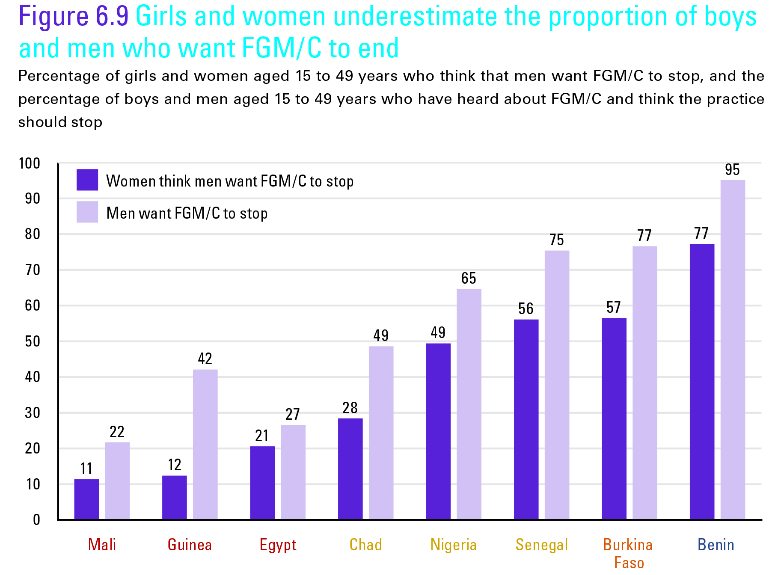

Slide 18
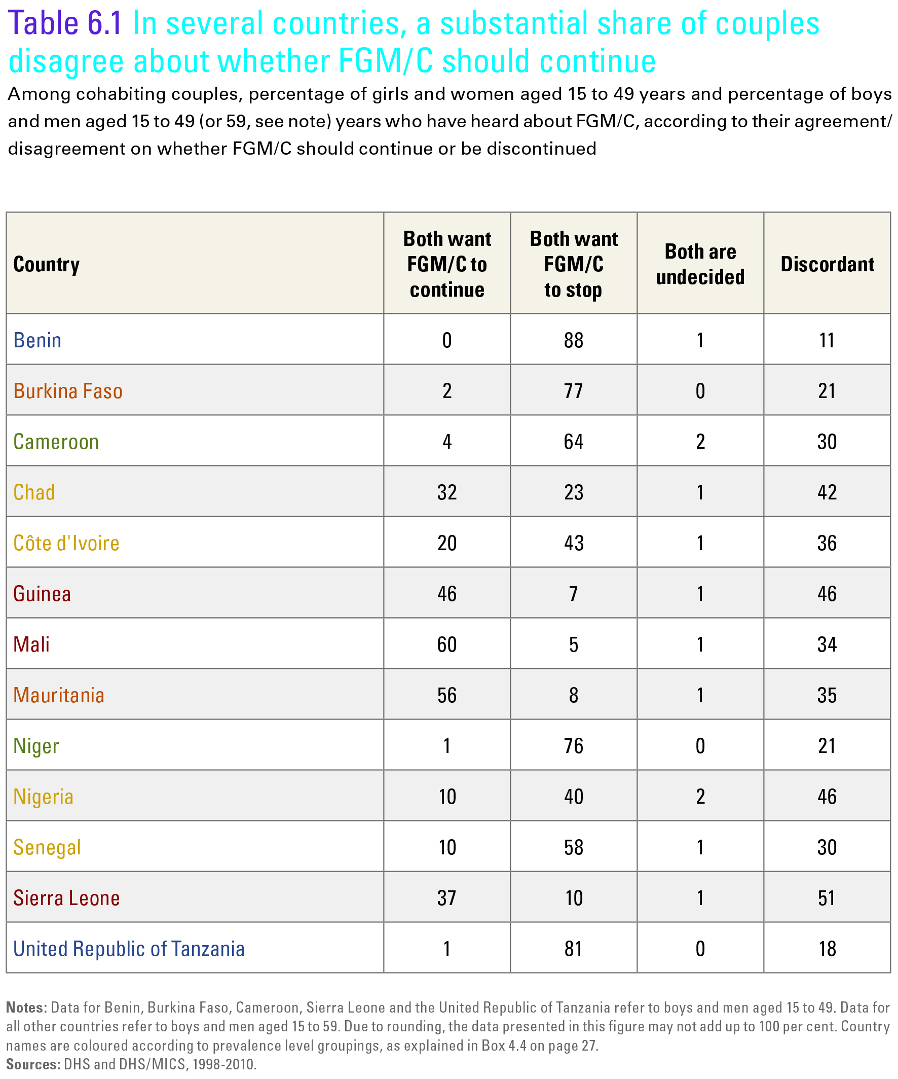

Slide 19
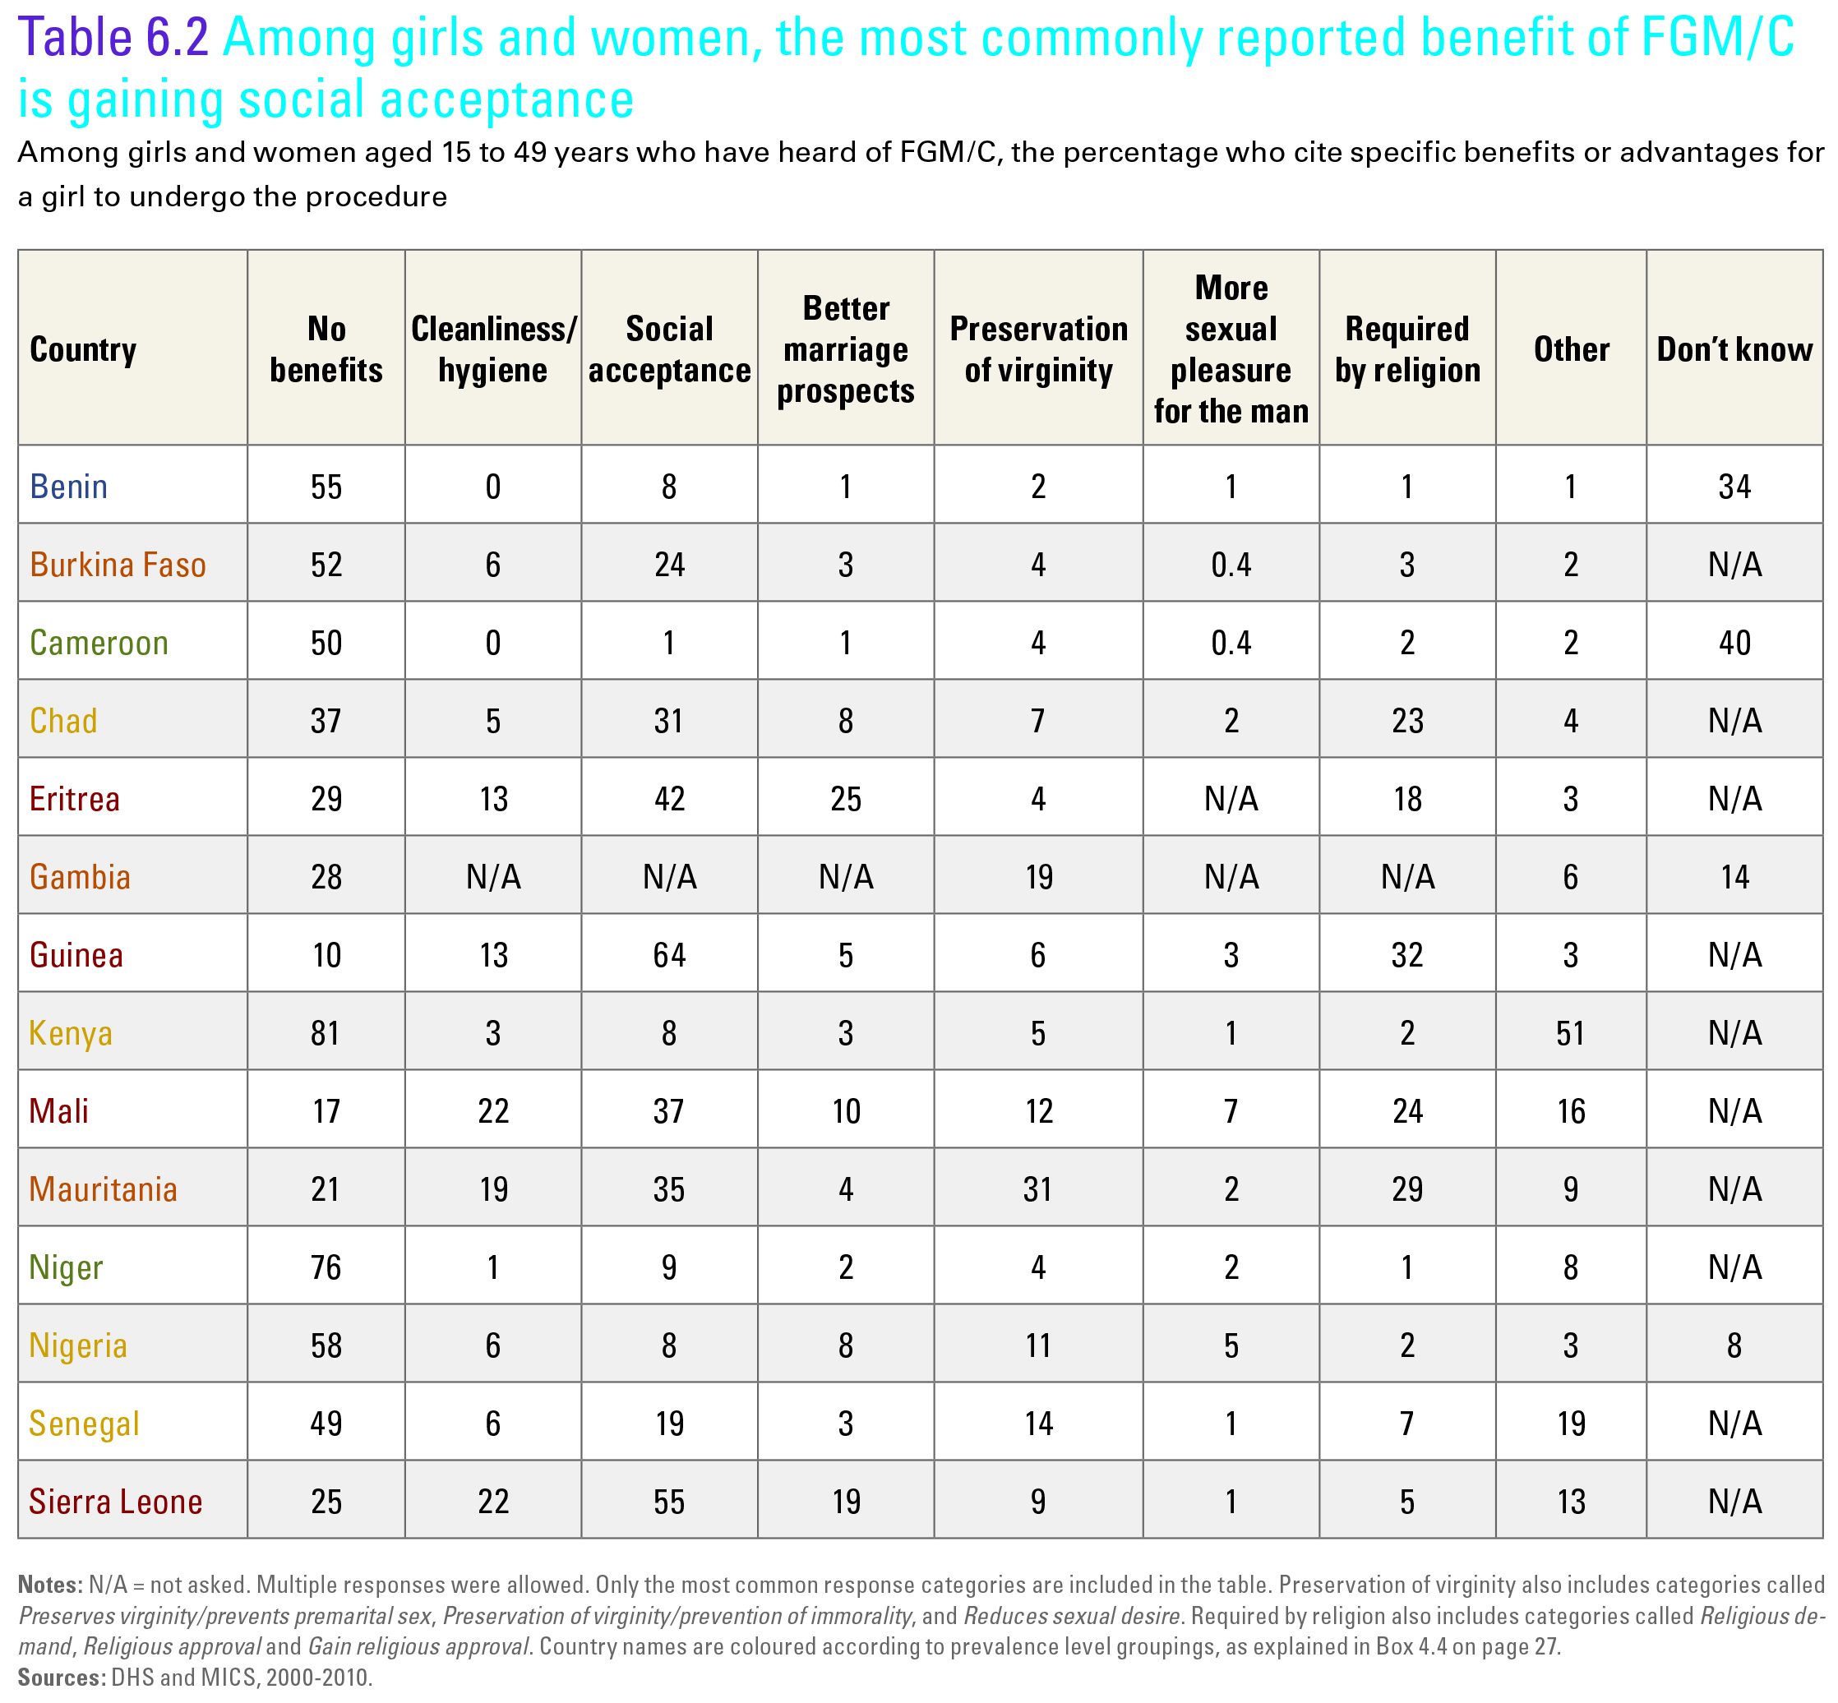

Slide 20
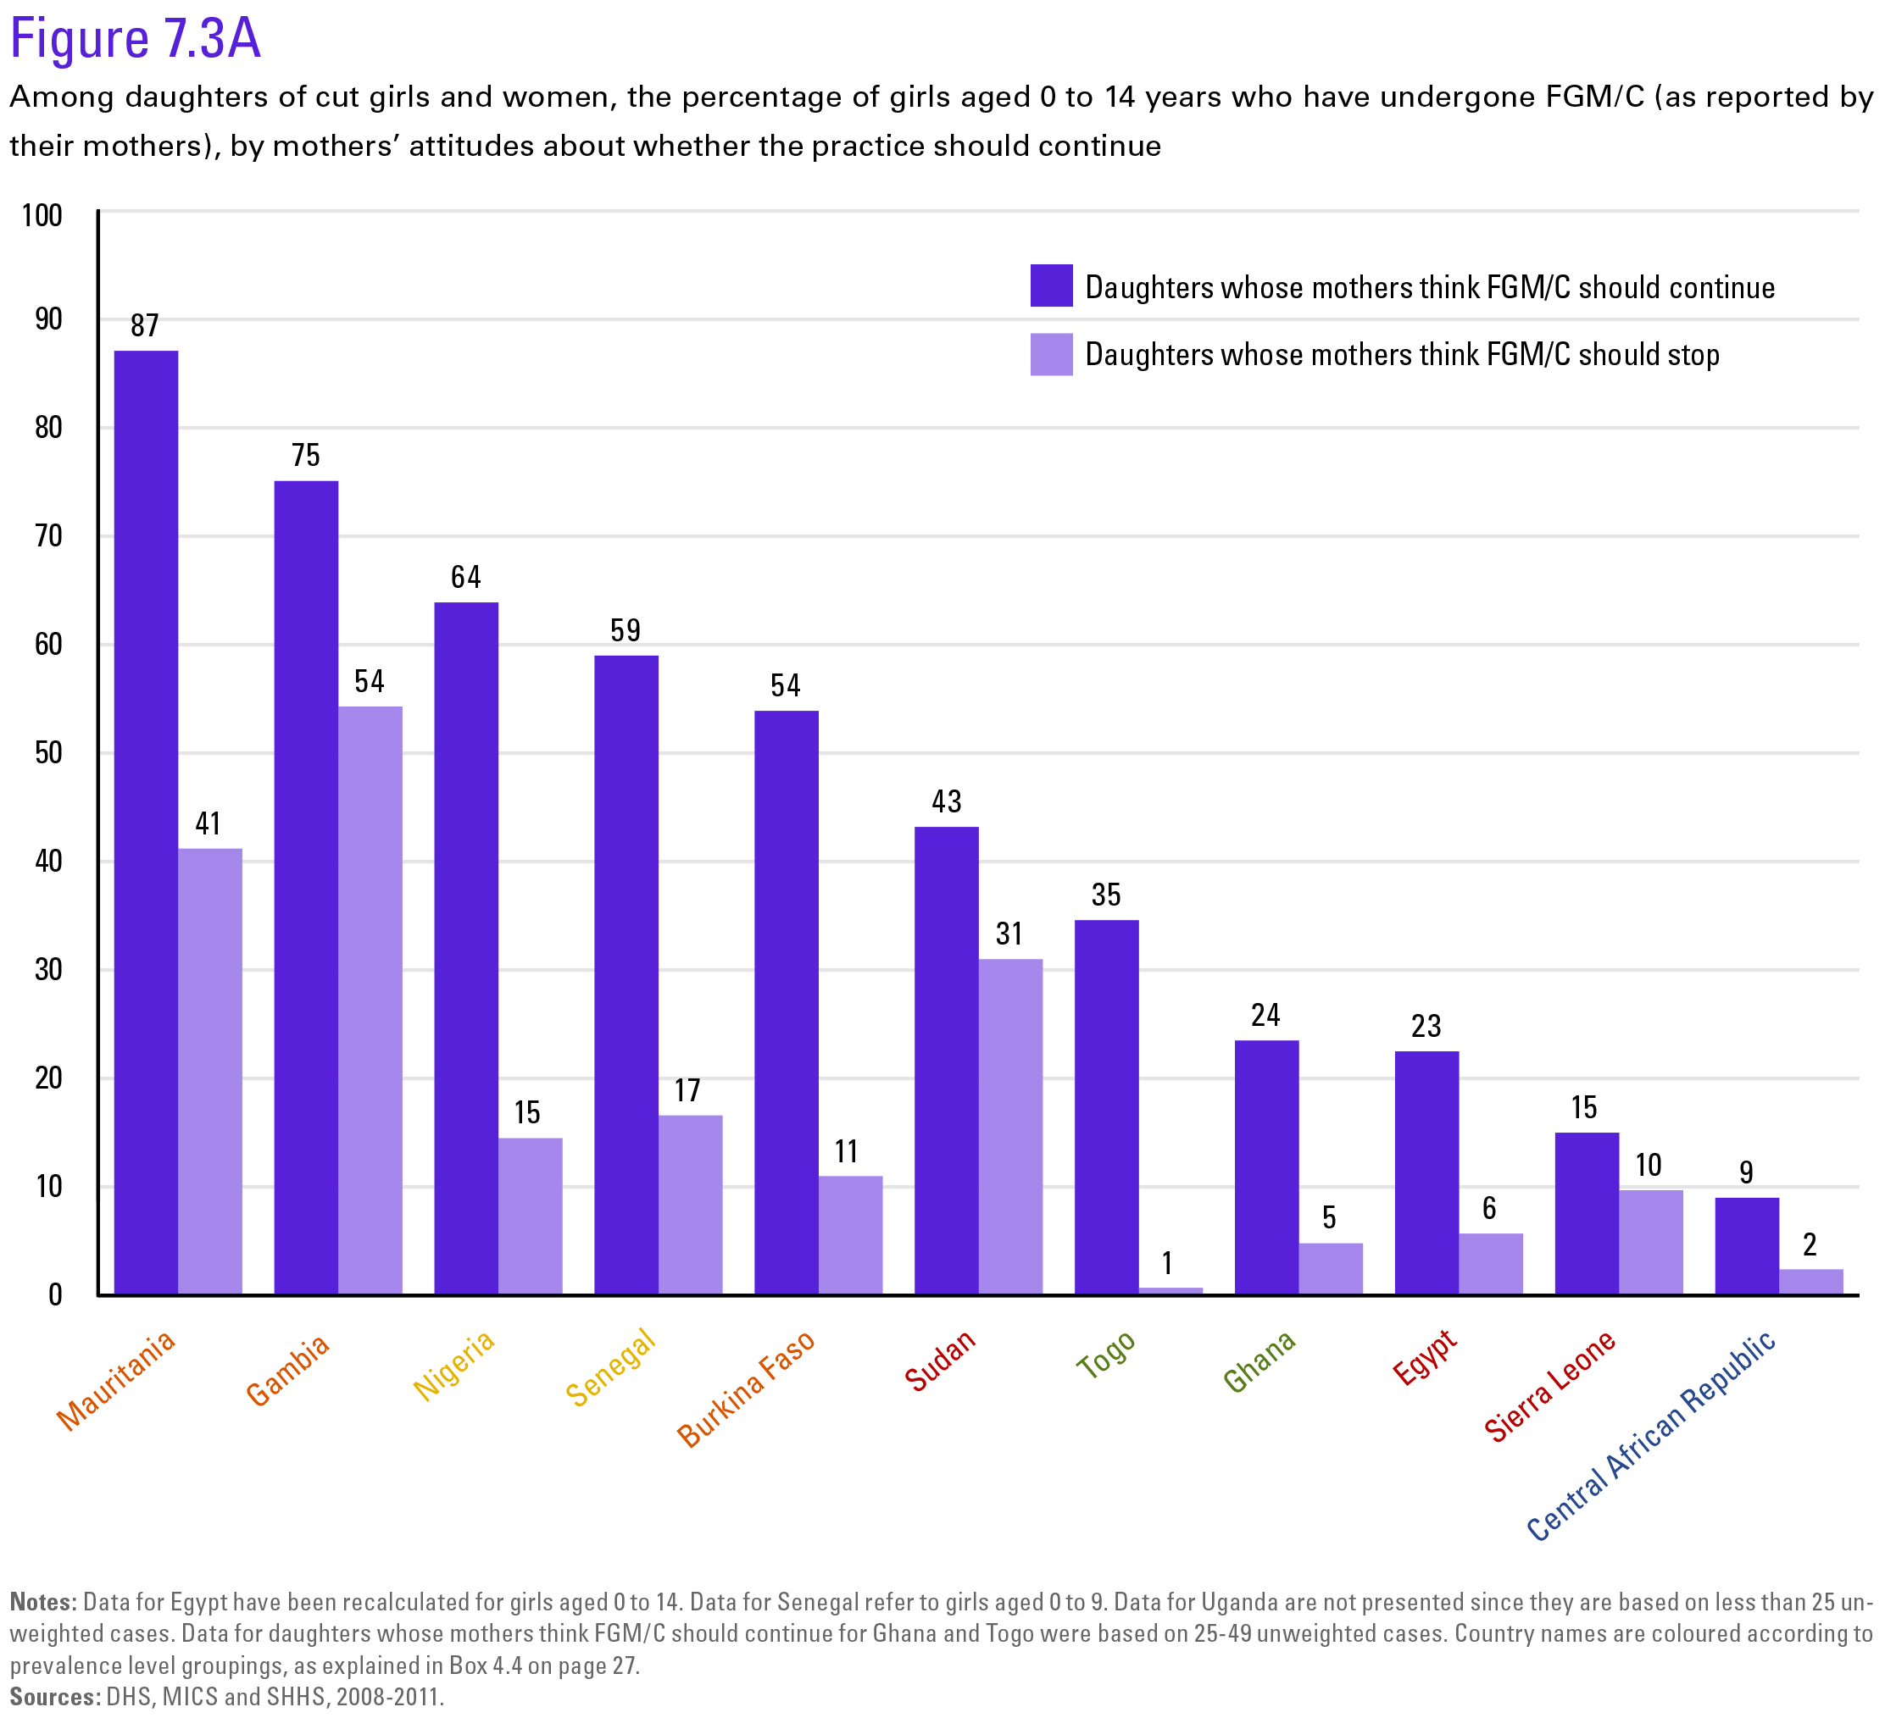
Many girls who are cut are daughters of women who want the practice to end

Slide 21
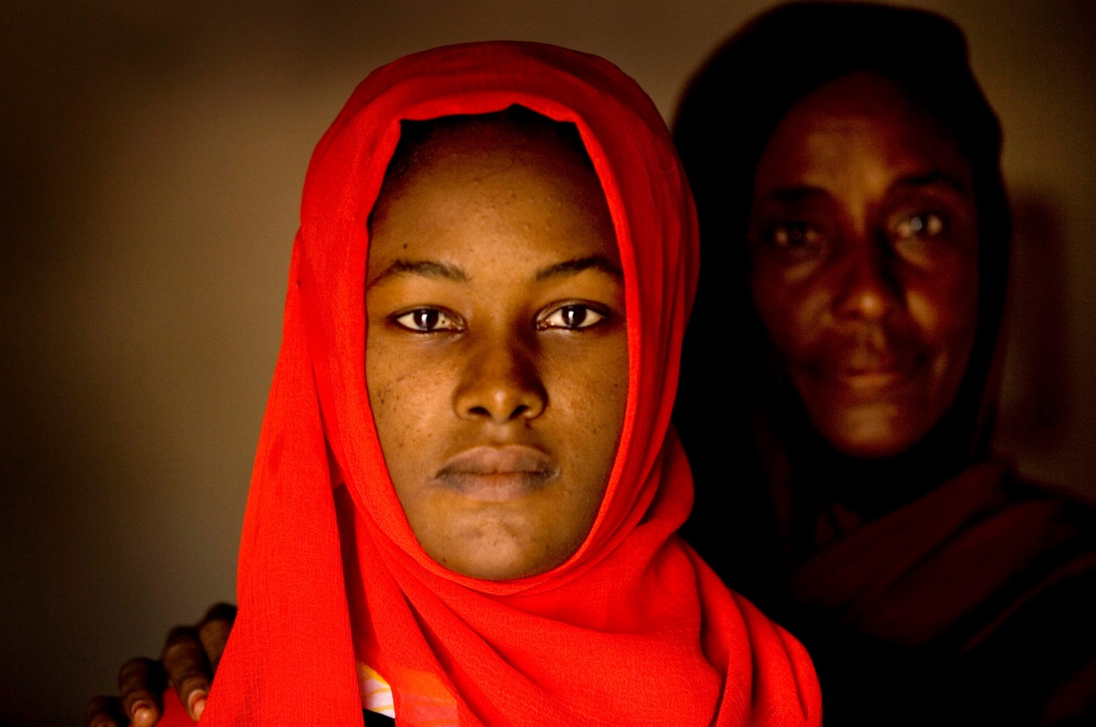
Is the practice changing?

Slide 22
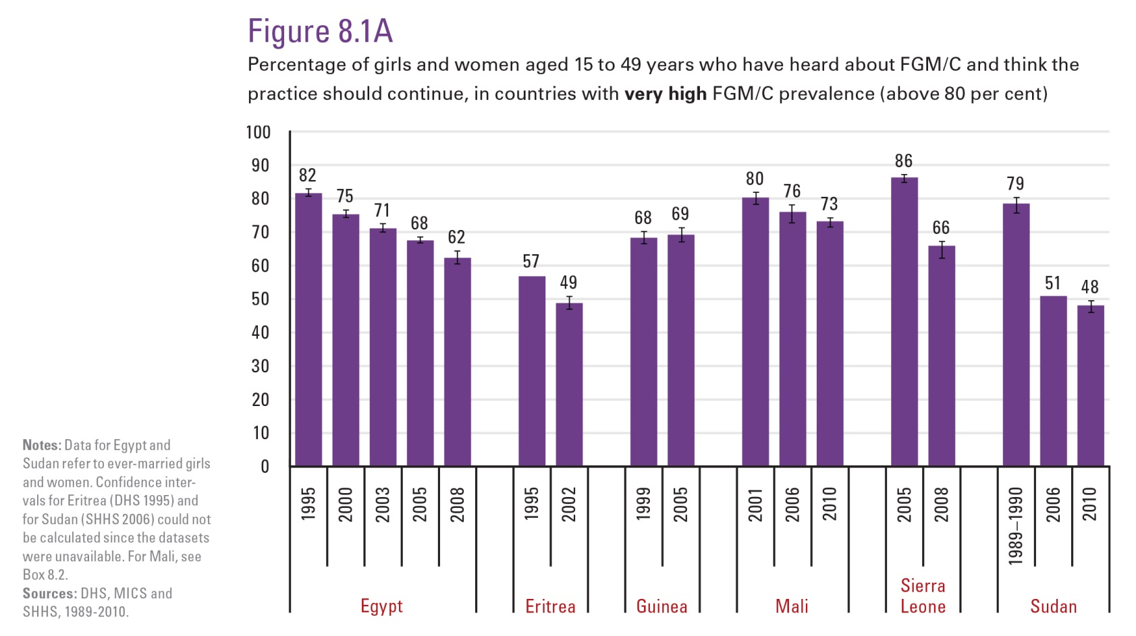

Slide 23
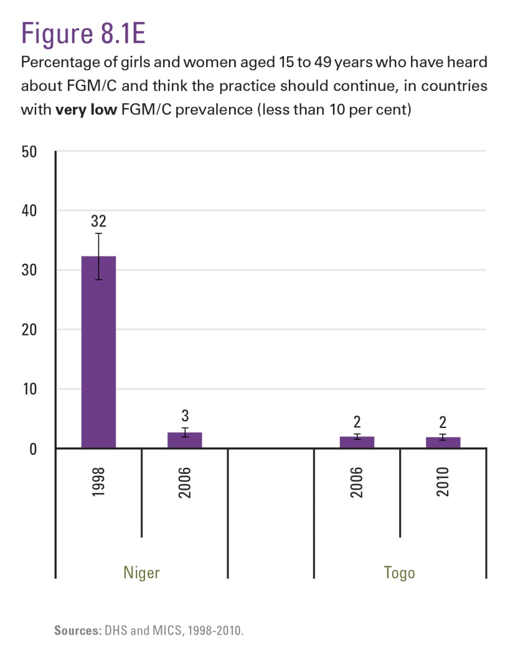

Slide 24
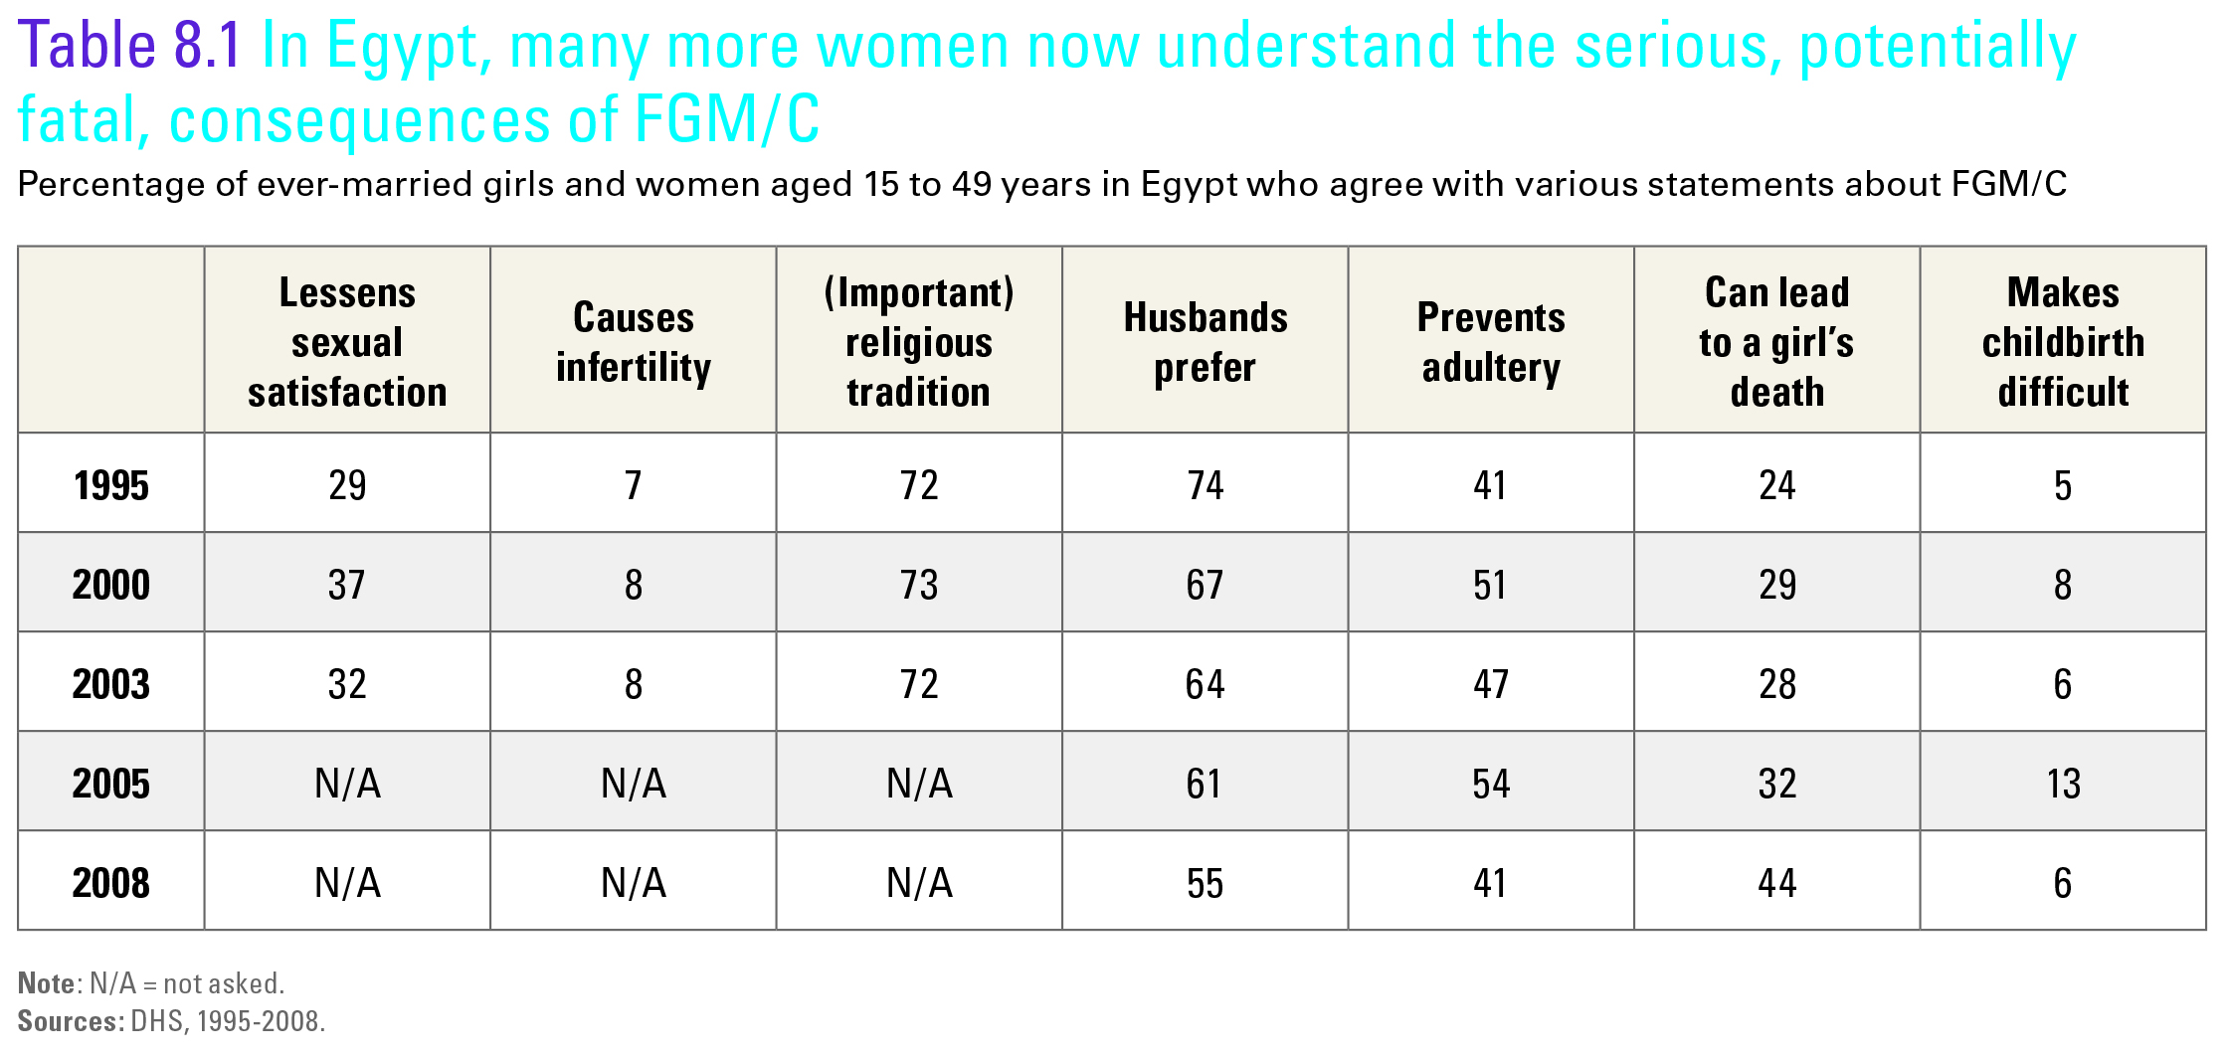

Slide 25
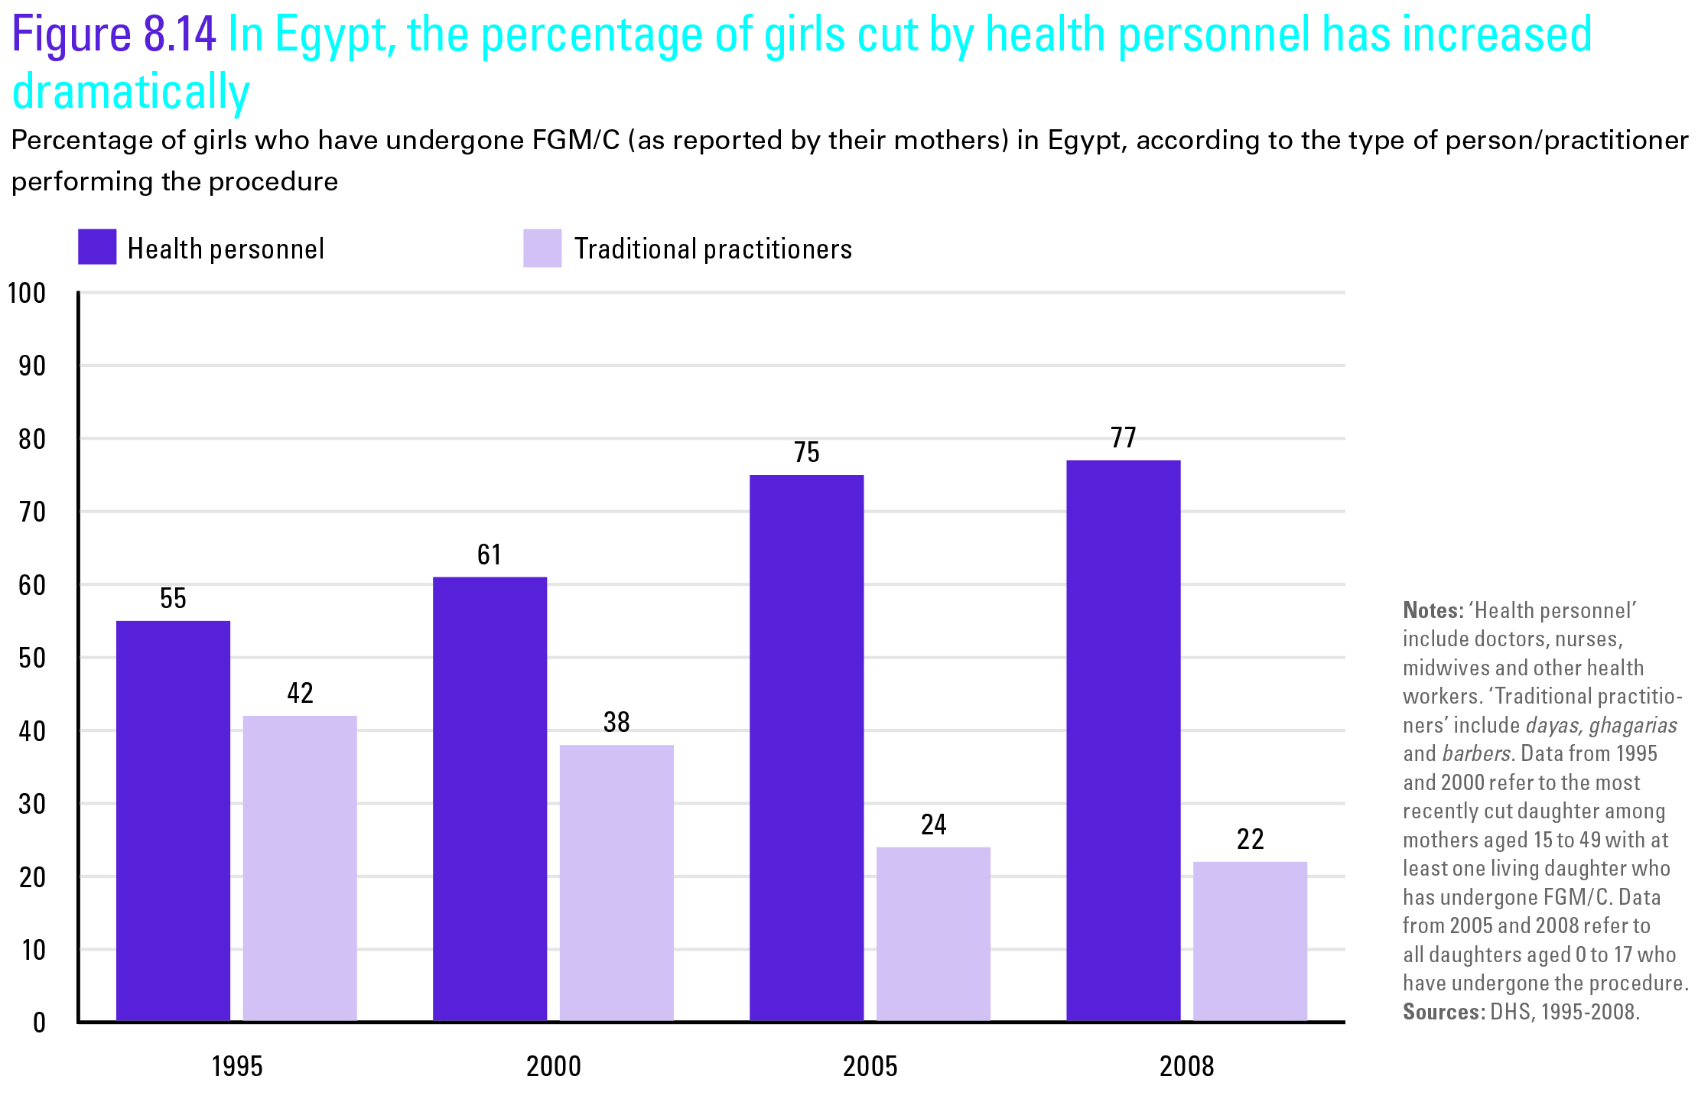

Slide 26
Things to consider
The time lag when interpreting current data and trends
Prevalence figures among girls aged 0 to 14 do not capture girls who have not yet been cut only because they are too young – need to be adjusted for trend analyses

Slide 27
Overall, younger women are less likely to have undergone FGM/C
than women in older age groups
Percentage of girls and women 15-49 years old who have been cut, by age group

Slide 28
Dramatic declines have occurred in some countries
Percentage of girls and women 15-49 years old who have been cut, by age group

Slide 29
No major declines are visible in others
Percentage of girls and women 15-49 years old who have been cut, by age group

Slide 30
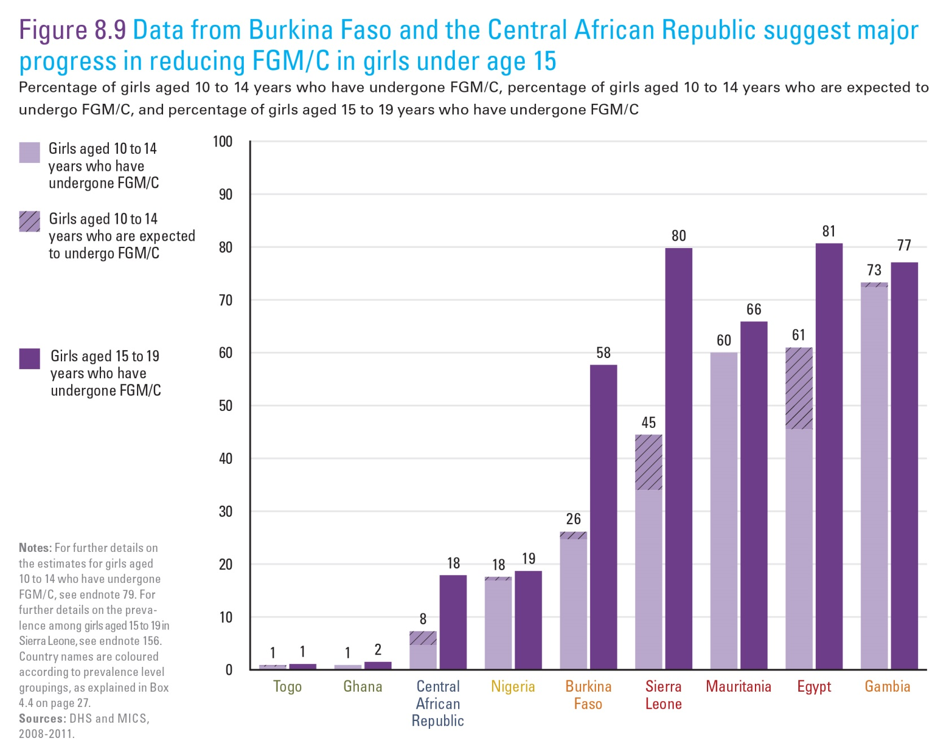

Slide 31
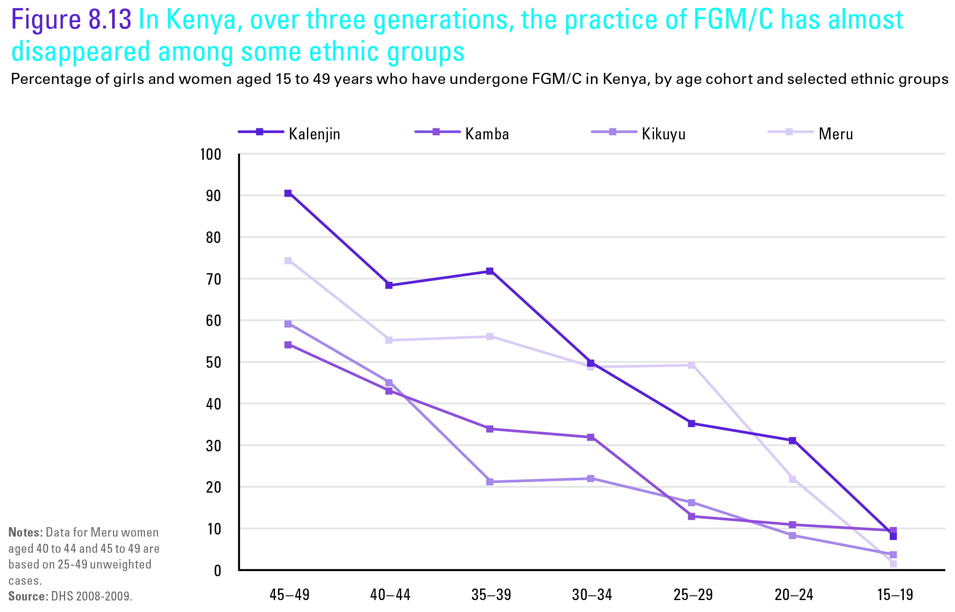

Slide 32
Summary remarks
Change is happening but at different paces
Greater change among countries of lower prevalence
Greater change in support than in prevalence

Slide 33
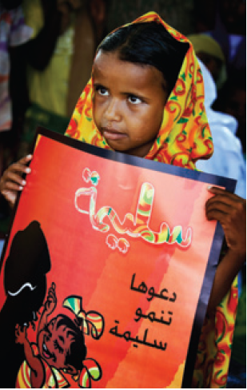
Thank you!
Acknowledgements
Ivana Bjelic
Yadigar Coskun
Cody Donahue
Lois Jensen
Francesca Moneti
Zhuzhi Moore
Nicole Petrowski
Bettina Shell-Duncan

